Slide 1
OASFAA UNDERSTANDING THE FAFSA TRAINING February 2022
Presented by:
MorraLee Keller, NCAN
Faith Phillips, Central Ohio Technical College/OSU Newark
outreach@oasfaa.org

Slide 2
About OASFAA & This Presentation
OASFAA is a non-profit organization for financial aid professionals. The Outreach Committee is comprised of OASFAA volunteers who serve as the primary resource of pertinent and current financial aid information. The committee provides this information through a variety of activities including training programs for various stakeholders external to OASFAA such as admissions staff, high school counselors, access advisors, TRIO, etc.
OASFAA is providing the information on the following slides as a free service to counselors.
You have permission to copy and distribute these materials to your students and families. Charges may not be assessed for the material or for the information presented. Permission must be granted for other use of this information or these materials. Contact the OASFAA Outreach Chairperson(s) listed on the OASFAA website or e-mail the OASFAA Outreach Committee at: outreach@oasfaa.org.

Slide 3
Workshop Agenda
What is the FAFSA?
Busting Financial Aid Myths
Busting FAFSA Myths
Why College
FSA ID
FAFSA Completion Details
Resources

Slide 4
What is the FAFSA?

Slide 5
What is the FAFSA?
Free Application for Federal Student Aid
Standard free form that collects information about the student and the parent.
Families should not pay to submit the FAFSA
Colleges use the calculated results of the FAFSA to determine eligibility for financial aid
Form is available at www.fafsa.gov

Slide 6
More about the FAFSA
For students attending college in 2022-2023, they complete the 2022-2023 FAFSA
Information collected on the form is used to calculate the
Expected Family Contribution (EFC)
The EFC is a measure of 2020 taxable and untaxable income and current assets of both student and parent
Many colleges set FAFSA filing priority dates
The earlier a student files, the earlier they may receive an aid offer and the more aid they may be offered

Slide 7
Busting Financial Aid Myths
Myth: The family makes too much money to be eligible for financial aid
Truth: Even if you don’t qualify for need-based aid, you may qualify for other aid
Myth: The FAFSA is only for federal financial aid
Truth: States, universities and some outside scholarship programs also use the FAFSA to determine aid
Myth: You won’t qualify for federal aid because you don’t have good grades
Truth: Federal aid isn't dependent on grades
Myth: I can declare myself an independent student
Truth: The federal government has very specific criteria for who may considered independent for federal aid

Slide 8
Busting FAFSA Myths
The FAFSA is too hard to fill out
My ethnicity or age makes me ineligible for aid
I only have to fill out the FAFSA once
I should not fill out the FAFSA until I have been accepted by a college(s)
The FAFSA does not have a deadline
I can’t file a FAFSA if my parents or I don’t file tax returns
I live by myself so I can just put my information on the FAFSA

Slide 9
Why go to college?

Slide 10
FSA ID

Slide 11
FSA ID - https://studentaid.gov/fsa-id/create-account/launch
The FSA ID is the electronic signature for the FAFSA
Used by student and parent(s) throughout financial aid process, including subsequent school years
Only the owner should create an FSA ID
Each student must have their own FSA ID
One parent must have their own FSA ID
FSA ID should be requested before starting the FAFSA

Slide 12
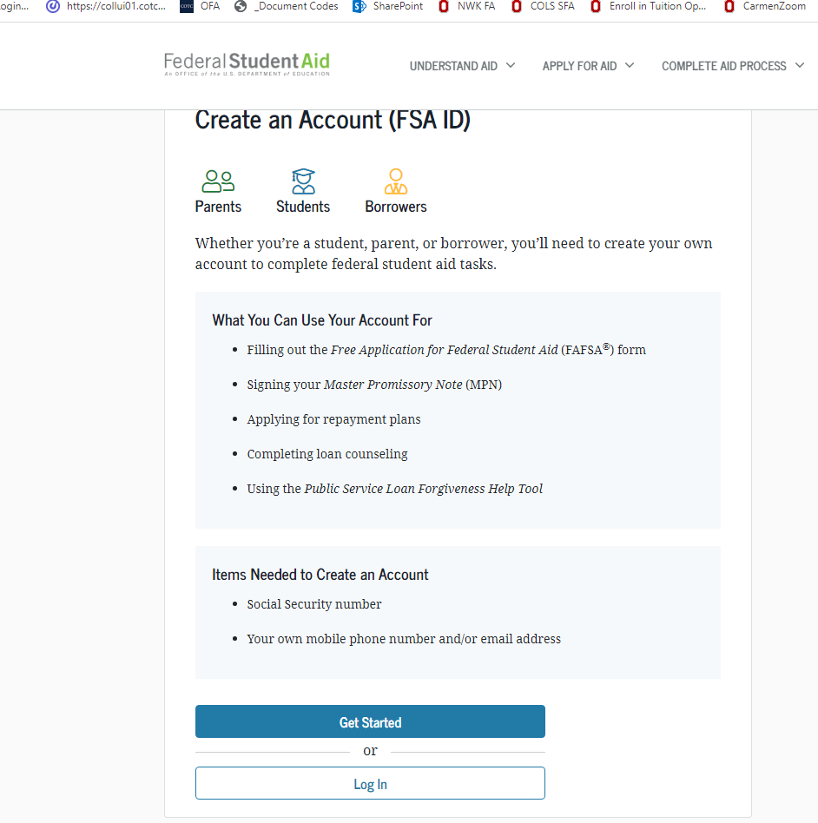
More on the fsa id
Name
Social Security Number
Date of Birth
Email address
Not High School Email
May only use an email one time
Mobile Phone Number
May only use a mobile number one time

Slide 13
Let’s Look at the FAFSA

Slide 14
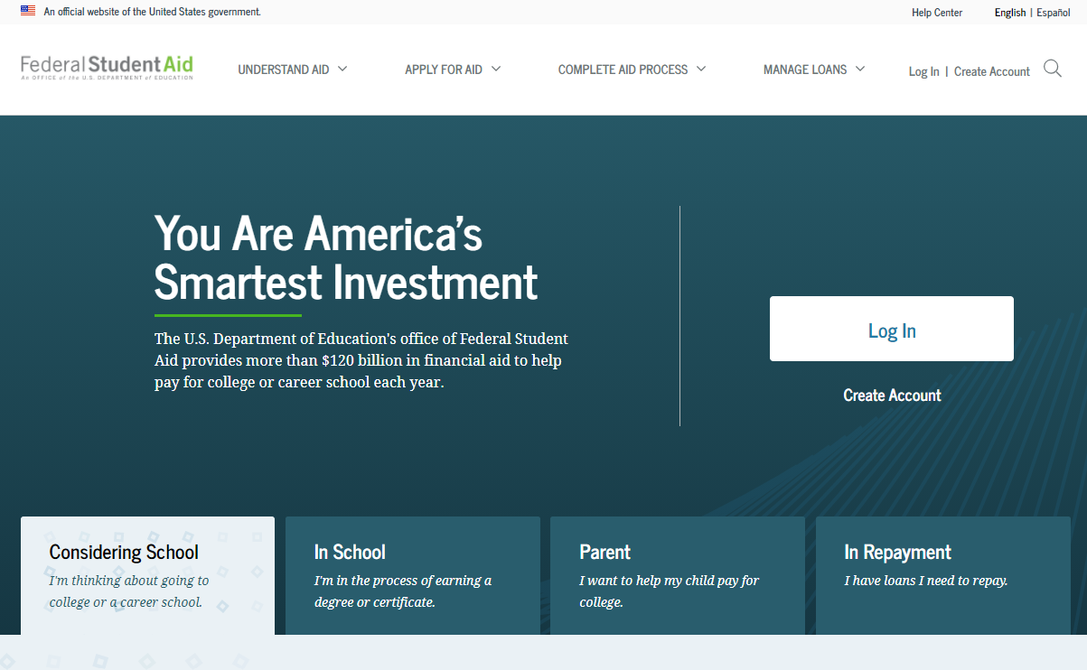
Studentaid.gov - homepage

Slide 15
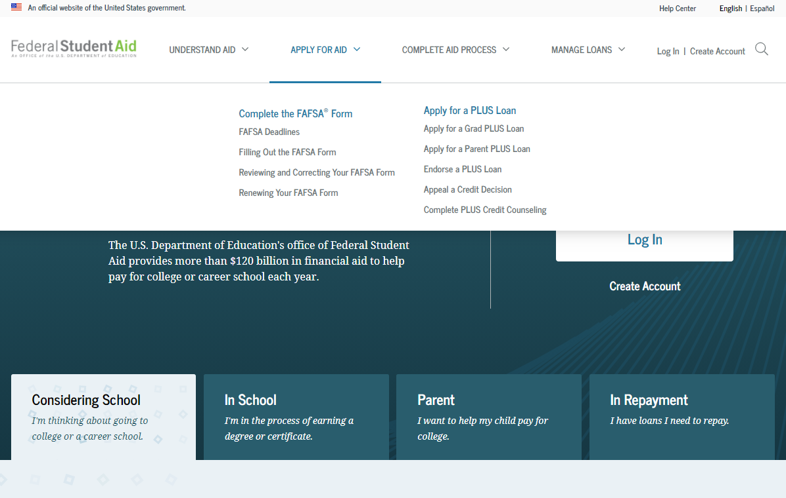
Apply for aid

Slide 16
Begin with “Start Here”
Once student record is established you will Log In each time

Slide 17
Fafsa on the web log-in

Slide 18
Select the correct year
Caution: two years will be displayed.
Students applying for aid for this coming fall will select the 2022-2023 year.

Slide 19
Filing the Wrong FAFSA year
Failing to use student’s legal name as it appears on their social security card
Transposing digits or inserting extra digits
Using incorrect Social Security Numbers/Date of Birth
Submitting wrong parent’s financial information/not including step-parent
What to include for investment/net worth
Missing financial aid deadlines

Slide 20
School Selection

Slide 21
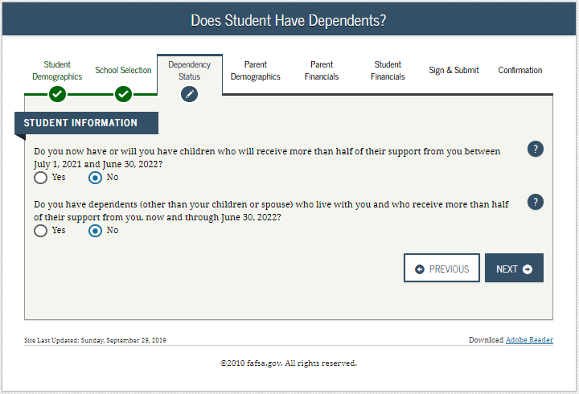
Dependency Status Determination
Answer “NO” to all questions, student is dependent and must provide parent information
Answer “YES” to any one question, student is independent and does not provide parent information

Slide 22
Dependency Status Determination

Slide 23
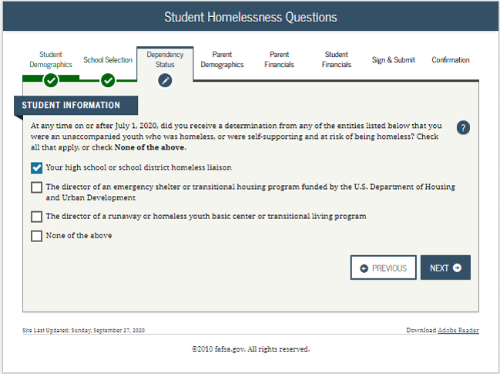
Homeless/at Risk For Homelessness
If applicant falls in this category, they will skip parental information and be considered Independent.

Slide 24
Student is determined to be Dependent

Slide 25
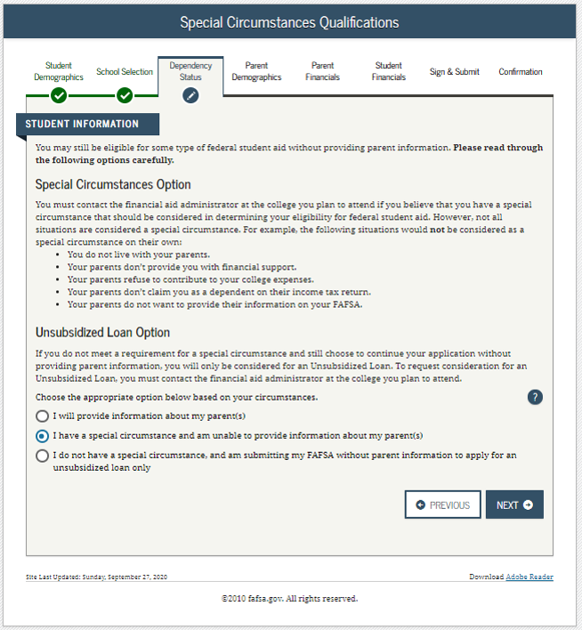
Student is determined to be Dependent but has Special Circumstances

Slide 26
WHO is the Parent for the FAFSA?
Biological or Adoptive Parent(s)
If not married BUT living together report BOTH parents
If parents are divorced:
Provide information for the parent you lived with most during the last 12 months
If you did not live with 1 parent more than the other, the parent who provided the most financial support during the last 12 months or most recent year you received support
Include Step-parent information
Regardless of any ‘agreements’

Slide 27
Parent Information
Information for Parent #1
Information for “Other Parent”

Slide 28
Household Information

Slide 29
IRS Data Retrieval Tool (DRT)
Allows for certain tax return information to be transferred from the IRS database
Participation is voluntary and student/parent chooses whether to transfer data to FAFSA
IRS will authenticate taxpayer’s identity
If 2020 tax record is found, IRS transfers information to populate the FAFSA
Reduces documents requested by financial aid office
Certain tax filers cannot use the DRT

Slide 30
Eligible for IRS DRT

Slide 31
Student and Parent Assets

Slide 32
Net worth of Assets (As of ‘today’)
Cash, Savings, and Checking
Investments/Business/Farm Value
Current/market value minus debt = Net Worth
Real estate (not home you live in), trust funds, money market and mutual funds, CD’s, stocks, bonds, commodities
Education benefits/savings accounts (Coverdell, 529, refund value of prepaid tuition plans)
Asset of the parent not student
Must include value of ALL accounts owned by parent

Slide 33
Assets NOT included on the FAFSA
Value of your primary residence
Value of Life Insurance
Traditional Retirement Plans
Business or farm with 100 or fewer full-time or full-time equivalent employees
Family Farm you live on and operate

Slide 34
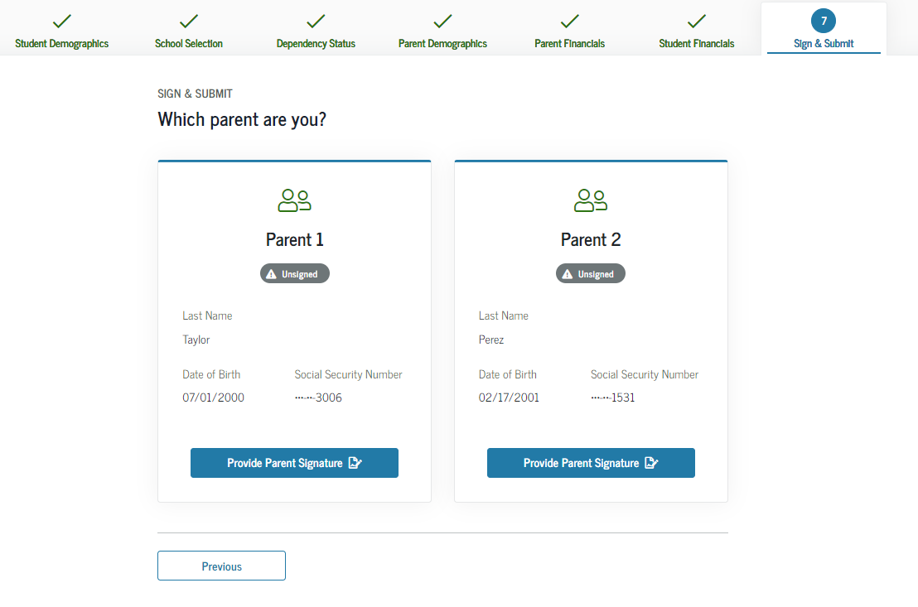
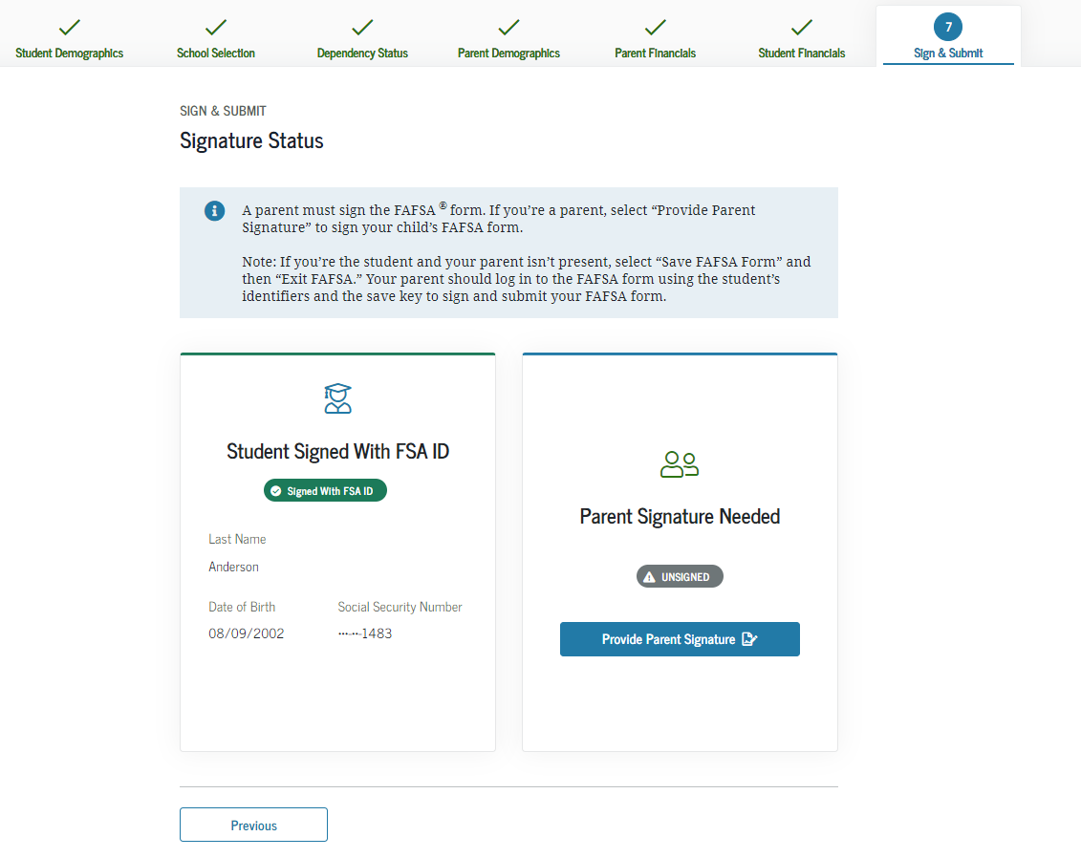
Sign
Other options to sign and submit
Print signature page OR Submit without signatures
“View or Print your FAFSA information

Slide 35
Submit

Slide 36
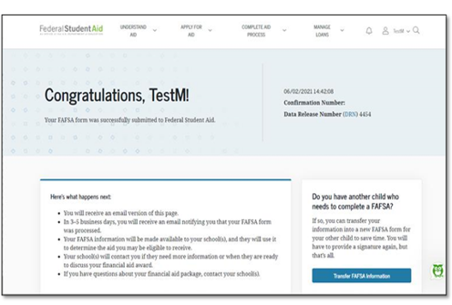
Confirmation Page
Includes -
Confirmation Number
EFC estimate
Pell Grant and Direct Loan estimates
Option for parents to transfer info to an application for a sibling

Slide 37
Resources

Slide 38
Resources – www.oasfaa.org
For additional training on the FAFSA you may want to view the FAFSA Line-by-Line Webinar available:
https://www.oasfaa.org/counselors

Slide 39
Resources for Students and Parents
Videos available here:
How to request an FSAID
Completing the FAFSA
After the FAFSA
About Federal Student Aid
https://www.oasfaa.org/fafsahelp

Slide 40
Additional fafsa assistance
School Counselors
College Access Program Advisors
Tax Preparers(Usually a fee)
Community Volunteers(if trained)
Financial Aid Personnel at Colleges
You

Slide 41
QUESTIONS????

