Slide 1
2020 OASFAA COUNSELOR WORKSHOPS October, November and December 2020
Presenters: [TYPE NAMES HERE]

Slide 2
ABOUT OASFAA AND THIS PRESENTATION
OASFAA is a non-profit organization comprised of financial aid professionals. The OASFAA Outreach Committee is an all-volunteer committee that serves as a primary resource of pertinent and current financial aid information. The committee disseminates this information through a variety of activities including training programs for various stakeholders external to OASFAA such as admissions staff, high school counselors, access advisors, TRIO, etc.
OASFAA has provided the information today as a free service to counselors.
You have permission to copy and distribute these materials to your students and families. Charges may not be assessed for the material or for the information presented. Permission must be granted for other use of this information or these materials. Contact the OASFAA Outreach Chairperson(s) listed on the OASFAA website or e-mail the OASFAA Outreach Committee at: outreach@oasfaa.org.

Slide 3
WORKSHOP AGENDA
FAFSA Updates
Federal Verification
Financial Aid Award Letters
Special Circumstances
Federal Aid Updates
State Aid Updates
Resources

Slide 4
FAFSA UPDATES FOR 2021-2022

Slide 5
FEDERAL STUDENT AID ID (FSAID)
https://fsaid.ed.gov
An FSA ID is a username and password that gives you access to Federal Student Aid’s online systems and can serve as your legal signature.
The student and one parent whose information is on the FAFSA will need their own individual FSA IDs.
The FSA ID (s) should be requested before beginning the FAFSA.
FSA ID requires an email address or mobile phone number. An email address and mobile number can only be associated with one FSA ID. Parents and Students cannot use the same email or mobile phone number.
Note: Students or Parents with recycled cell phone numbers may need to reach out to an FSA Specialist
Students should not use a high school email address because it will be deleted after graduation.

Slide 6
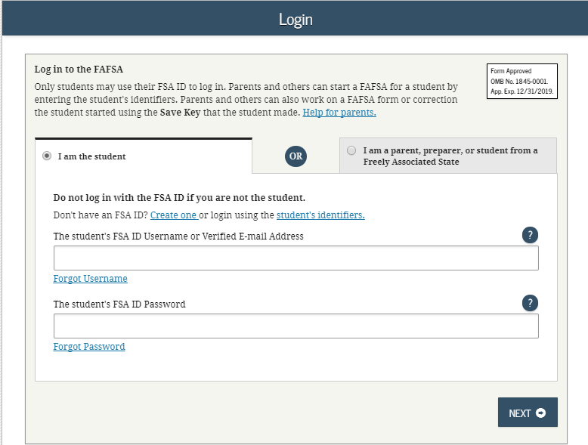
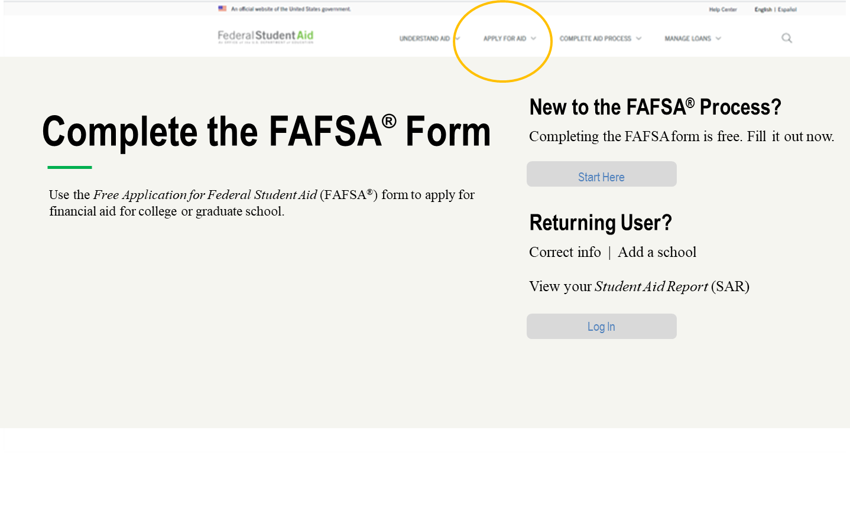
FAFSA on the WEB (FOTW)

Slide 7
FAFSA UPDATES FOR 2021-2022
A change for the FAFSA for 2021-2022 is to the way the Schedule 1 question is processed and defined:
The answer to “Did your parent file a Schedule 1 with the IRS Form 1040?” in the Parent Financials section, and the answer to “Did you file a Schedule 1 with the IRS Form 1040?” in the Student Financials section can now be transferred by the IRS if the IRS DRT is used.
Students and parents will see “Transferred from IRS.”
For those who do not use the IRS DRT, the help topics connected to the Schedule 1 questions have been updated to include all current exceptions. “Capital Gains” has been removed as an exception and “Virtual Currency” has been added.

Slide 8
FAFSA UPDATES FOR 2021-2022
The income threshold for an automatic zero Expected Family Contribution (EFC) increased from $26,000 to $27,000.
Line item changes on the 2019 tax return have resulted in changes to the FAFSA (families strongly encouraged to use IRS DRT).
The question regarding untaxed portion of IRAs and untaxed portion of pensions is no longer combined.

Slide 9
FAFSA COMPLETION NUMBERS

Slide 10
NATIONAL/OHIO OVERVIEW OF FAFSA COMPLETIONS
As of 9/11/20 – Nationally Class of 2020 was down 4.2% compared to Class of 2019.
Only 1 state had an increase this year – Hawaii.
As of 9/11/20 – Ohio Class of 2020 was down 5.7% compared to Class of 2019. That equates to about 4700 less FAFSAs completed.
As of 9/11/20 – Ohio has the 15th highest completion rate in the country with 64.3% of the Class of 2020 (77,264 FAFSAs).
Ohio gained 6.7% in new completed FAFSAs between June 30 and September 11.
Ohio has received 3.3% fewer FAFSAs from all students (new and returning) compared to this time last fall (17,400 fewer FAFSAs).

Slide 11
Number of Schools Selected On FAFSA
All filers
2020-21 Cycle (Freshman)

Slide 12
TRACKING FAFSA COMPLETION
To look at aggregate number and comparison options:
www.formyourfuture.org/fafsa-tracker
Compare this year versus last year at the state, city, district or building level:
To look at student level data for Ohio: https://www.ohio-k12.help/fafsa/
Need Data sharing agreement signed by Superintendent.
Site indicates that 2021-2022 FAFSA data will be available in early October.
Many enhancements done this past spring to the Ohio site.

Slide 13
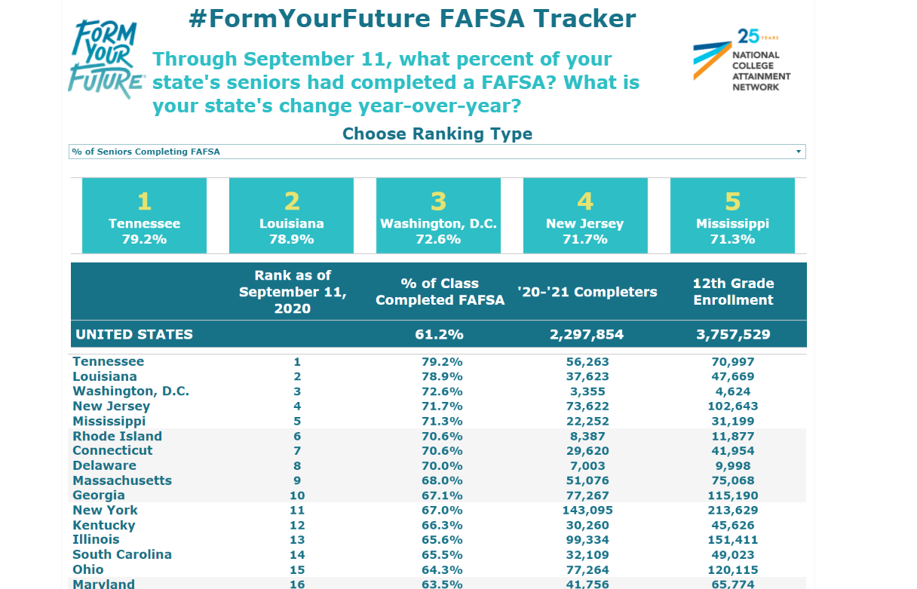

Slide 14
FEDERAL VERIFICATION

Slide 15
VERIFICATION
Students may be selected for a process called verification and must submit documents to confirm FAFSA information.
Roughly 22% of FAFSAs are selected for verification by the U.S. Department of Education.
Students should respond quickly to any requests for information from the college.
If selected, commonly requested documents include:
Verification Worksheet (these can look different across varying colleges and universities)
Federal Tax Return Transcript or Federal Tax Return for parents/student if they filed 2019 taxes
An alternative to submitting documentation of taxes is completing the IRS Data Retrieval Process within the FAFSA
W-2(s) for parents/students if they worked in 2019 but did not file taxes
Verification of Non-Filing Letter for parents and independent students who did not file 2019 taxes – this is NOT needed for dependent students

Slide 16
VERIFICATION
Federal Income Tax Return
Institutions may accept a signed copy of the federal income tax return for the applicable tax year that the tax filer submitted to the IRS or other relevant tax authorities (this includes a signed copy of the income tax return for amended tax filers and victims of identity theft).
IRS Tax Return Transcripts
Institutions may accept a signed copy of the IRS Tax Return Transcript which can be requested at https://www.irs.gov/individuals/get-transcript or 1-800-908-9946.
Via online account creation or request to be mailed
Can no longer have Tax Return Transcripts mailed to a third party (i.e. directly to the college or university)

Slide 17
VERIFICATION
“Will File” 2019 Taxes
If selected for verification…
School must verify that student/parent did file
Schools are only permitted to accept extensions beyond the standard 6-month extension for:
HEROES Act (Individual called upon for Active Duty or National Guard Duty) or
IRS Letter of Approval for extension beyond 6-months
If a student is not selected by the federal processor, a school may choose to institutionally select the FAFSA for verification if they have reason to question something.

Slide 18
VERIFICATION
Important to Note about Verification:
Financial Aid Administrators (FAAs) are not required to be tax experts; however, Federal Student Aid does require FAAs to know when a student or parent is required to file taxes and to verify that they filed their tax return properly.
FAAs have the authority to request that a student/parent file a tax return or amend their tax return if they determine they should have filed or filed incorrectly. Until the college receives the requested information, financial aid eligibility will not be determined.

Slide 19
FINANCIAL AID AWARD OFFERS Comparison of aid and costs

Slide 20
FINANCIAL AID AWARD OFFERS
Why are award offers so confusing?
Delivery methods vary among colleges and universities – paper version, email version, online portal version, etc.
Formatting variations:
Schools rarely use the same template/layout.
Language variations:
Sub Loan, Direct Sub Loan; Federal Direct Subsidized Loan: what’s the difference?

Slide 21
FINANCIAL AID AWARD OFFERS
Why are award offers so confusing? (Continued)
Are the awards automatic, or require additional action? If so, what action is needed?
How clear are the parameters on the letter?
Does the school provide information on the letter? Supplemental document with guidance? Call to action/next steps?
How does the school deal with Federal Work Study, Parent PLUS Loan, Private Education Loans, and/or Income Share Agreements?
Are there charges on the letter?
If so, are they estimated or actual?
Do they include only direct charges, or direct and indirect charges?

Slide 22
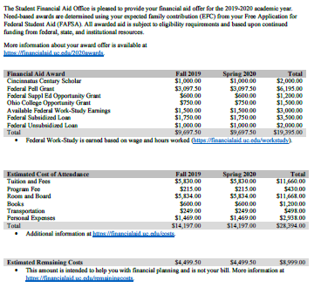
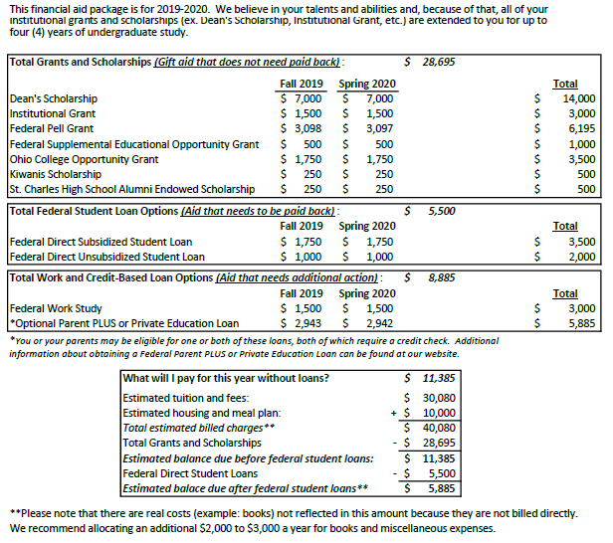
Two award offers, two different types of institutions, two different layouts

Slide 23
Gift Aid (GRANTS AND SCHOLARSHIPS)

Slide 24
FEDERAL STUDENT LOANS

Slide 25
WORK STUDY AND CREDIT-BASED LOAN OPTIONS

Slide 26
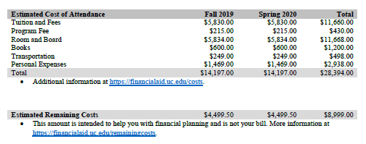
ESTIMATED COST OF ATTENDANCE & REMAINING COSTS

Slide 27
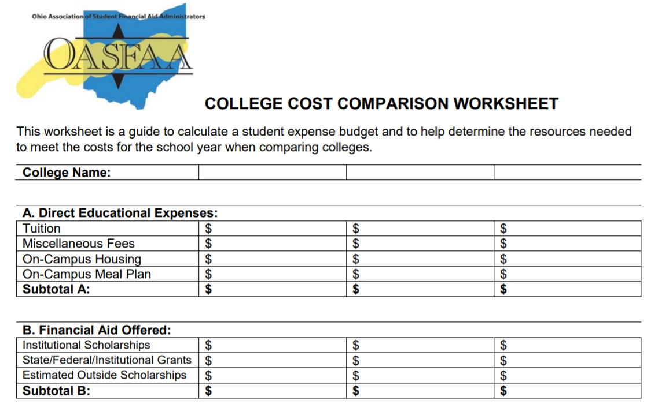
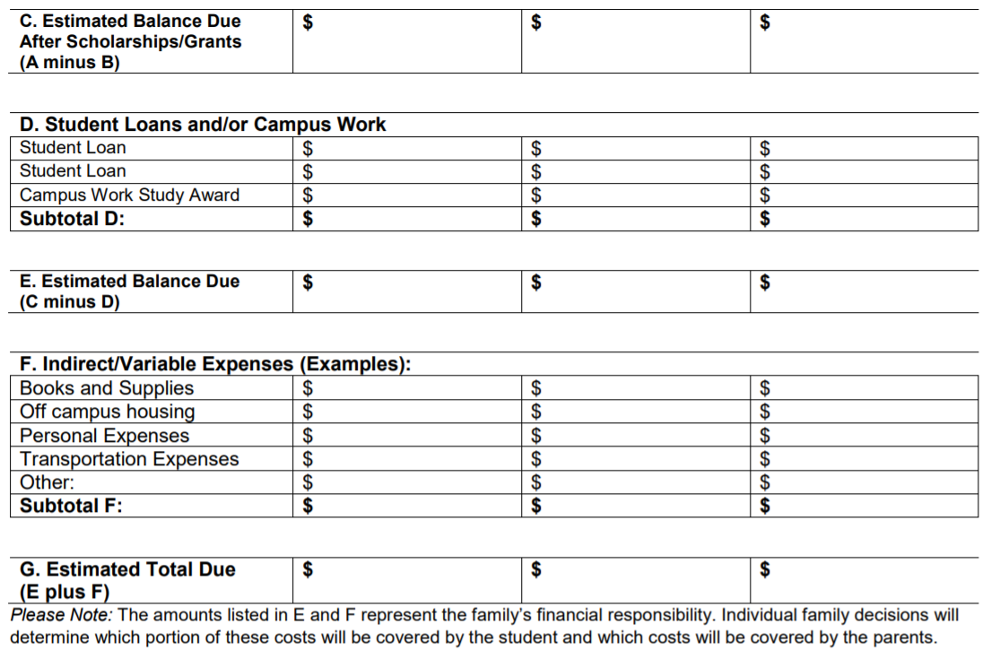
Comparison Tools
There are some great, free tools available!
OASFAA College Cost Comparison Worksheet:
https://www.oasfaa.org/assets/docs/CostAndFinancialAidComparisonWorksheet.pdf

Slide 28
SPECIAL CIRCUMSTANCES

Slide 29
SPECIAL CIRCUMSTANCES
Eligibility for financial aid in 2021-2022 will be based on the 2019 tax year which may not be indicative of a family’s continuing ability to pay for educational expenses.
To remedy this, a financial aid administrator may evaluate special circumstances on a case-by-case basis, with adequate documentation, to better reflect a family’s financial picture.
Special Circumstances are conditions that exist which cannot be explained/documented on the FAFSA. Examples:
Loss or reduction of employment, wages, or unemployment compensation
Loss of untaxed income or benefits such as child support
Separation, divorce or death after the FAFSA was submitted

Slide 30
SPECIAL CIRCUMSTANCES
Before presenting a special circumstance to the college, students must first file the FAFSA as directed with 2019 taxed and untaxed income.
Most colleges have an appeal process to address special circumstances.
The student should complete the appropriate appeal form which may include:
An explanation of the change in circumstance
Documentation to support their statement:
Layoff or termination letter
Tax returns, w2’s, paystubs, other sources to document earned and anticipated income
An estimate of future or current income
The college will review and determine if the change would impact the student’s eligibility and update the FAFSA as appropriate.

Slide 31
SPECIAL CIRCUMSTANCES
If applying to more than one college, students will appeal at all universities they are considering.
Appeal decisions are at the discretion of the university’s financial aid office and are final.
Cannot be appealed to the U.S. Department of Education.
Verification (if selected) must be completed prior to an appeal being reviewed.
Some colleges may require a student to complete verification on income and household prior to reviewing an appeal even if they were not selected by federal student aid.
Due to the Covid-19 pandemic, schools are preparing for an increase in appeals based on losses of income in 2020.

Slide 32
SPECIAL CIRCUMSTANCES
While the FAFSA for 2021-2022 is available beginning October 1, 2020, financial aid offices may not be prepared to discuss the appeal process until later in the year or early part of 2021.
Most colleges will have appeal forms on their website or portal and may be titled differently from college to college such as:
Expected Family Contribution Appeal
Income Appeal
Special Circumstances Appeal
Free resource to assist with a special circumstance appeal:
https://formswift.com/swift-student

Slide 33
EXAMPLES OF SPECIAL CIRCUMSTANCES
Loss of Child Support
Unusual uncovered medical/dental expenses
Extraordinary dependent care
Parent or spouse death
Loss of income/ employment
Divorce

Slide 34
AID PROGRAMS

Slide 35
FEDERAL AID PROGRAMS
Pell Grant
TEACH
Campus Based Programs
Direct Loans

Slide 36
FEDERAL PELL GRANT 2020-2021
Maximum award amount increased slightly for 2020-2021.
$6,345 maximum award for full-time enrollment and an Expected Family Contribution (EFC) of zero.
Maximum Expected Family Contribution (EFC) for Pell eligibility increased to 5711 for 2020-2021; it has not yet been established for 2021-2022.

Slide 37
FEDERAL PELL GRANT 2020-2021
Students have a maximum number of terms they can receive Pell Grant.
600% of an annual award amount, or the equivalent of 12 full time semesters.
Year-round Pell Grants remain.
Students can attend on a year-round basis and receive up to 150% of their annual award.
Serves as an incentive to complete the credential/degree.
Still have the 12 full-time semester limit for receiving the Pell Grant.

Slide 38
TEACH GRANT 2020-2021
For any 2020–21 TEACH Grant first disbursed on or after Oct. 1, 2020, and before Oct. 1, 2021, the maximum award of $4,000 is reduced by 5.7 percent ($228).
Grant of up to $3,772 per year to students who intend to teach in a public or private elementary or secondary school that serves students from low-income families.
Service requirement upon graduation must be met, or grant becomes an Unsubsidized Direct Loan that must be re-paid!

Slide 39
CAMPUS BASED PROGRAMS 2020-2021
Can vary significantly in amount between colleges and universities.
“Priority Deadlines” can impact eligibility between schools.
For most schools, FWS earnings are given in paycheck form and not applied directly to the student’s bill.
Federal Supplemental Education Opportunity Grant (SEOG)
Federal Work-Study

Slide 40
FEDERAL WORK-STUDY (FWS)
Undergraduate or graduate students are eligible.
Employment can be on or off campus.
FWS wages are excluded from EFC calculation.
Ohio Minimum Wage in 2020 is $8.70/hour.
There is a difference between work study and “work” or “employment” on an award letter.

Slide 41
FEDERAL SEOG
Undergraduates with exceptional financial need (Pell Eligible students with the lowest EFC).
Award ranges from $100 to $4,000, depending on when student applies, financial need, and the funding and policies of school attending.

Slide 42
DIRECT LOANS: UNDERGRADUATE 2020-2021
Direct Subsidized and Unsubsidized Loans are two separate, unique types of loans that are awarded separately.
Subsidized Undergraduate | Unsubsidized Undergraduate
Need based | Not based on financial need
Interest is fixed at 2.75% for new undergraduate loans disbursed during 2020-21*; interest is subsidized while the student is in school and during deferment. | Interest is fixed at 2.75% for all new loans disbursed during 2020-21*; interest accrues from time of disbursement of the funds.
*Interest rates recalculated annually and are effective July 1st based on the 10-year treasury note index plus 2.05%, capped at 8.25%

Slide 43
DIRECT LOANS 2020-2021 (NO CHANGES)
Class Year | Maximum Subsidized Amount | Additional Unsubsidized Amount | Total Available to Borrow
Freshman | $3,500 | $2,000 | $5,500
Sophomore | $4,500 | $2,000 | $6,500
Junior | $5,500 | $2,000 | $7,500
Senior | $5,500 | $2,000 | $7,500
Undergraduate Independent Students and Dependent Students whose parents have been denied the PLUS Loan are eligible for additional Direct Unsubsidized Loans ($4,000 as Freshmen and Sophomores and $5,000 as Juniors and Seniors).

Slide 44
DIRECT LOANS: GRADUATE 2020-2021
Graduate students are only eligible for Unsubsidized Loans (not subsidized).
Unsubsidized Graduate
Not based on financial need
Interest is fixed at 4.30% for all new loans disbursed during 2020-21*; interest accrues from time of disbursement of the funds.
Did you know?
Graduate students have higher loan limits than Undergraduate Students as they can borrow $20,500 annually.
*Interest rates recalculated annually and are effective July 1st based on the 10-year
Treasury note index plus 3.60%, capped at 9.5%

Slide 45
INCOME-DRIVEN REPAYMENT PLANS
There are now four income-driven repayment plans:
Income Contingent Repayment (ICR)
Income-Based Repayment (IBR)
Pay As You Earn (PAYE)
Revised Pay As You Earn (REPAYE)
These plans are designed to give students peace of mind related to the affordability of their student loan payments.

Slide 46
PUBLIC SERVICE LOAN FORGIVENESS
Under this program, borrowers may qualify for forgiveness of the remaining balance of their Direct Loans after they have made 120 (10 years worth of) qualifying payments on those loans while simultaneously employed full time by certain public service employers and/or any non-profit employer.
Only loans borrowers received under the William D. Ford Federal Direct Loan (Direct Loan) Program are eligible for PSLF.
There are many rules that must be followed.

Slide 47
FEDERAL PARENT PLUS LOAN
Parent PLUS
Loan to parents of dependent students
Loan limits are up to the cost of education less any financial aid received
Interest rate is 5.30% fixed*
Repayment begins within 60 days of full disbursement; payments may be deferred while the student is in school
FAFSA completion is required
*Interest rates recalculated annually and are effective July 1st based on the 10-year Treasury note index plus 4.6%, capped at 10.5%

Slide 48
STATE AID PROGRAM UPDATES
Ohio College Opportunity Grant (OCOG)
Nurse Education Assistance Loan Program (NEALP)
War Orphan & Severely Disabled Veterans’ Scholarship
National Guard Scholarship
Safety Officers Memorial
Choose Ohio First

Slide 49
OHIO COLLEGE OPPORTUNITY GRANT (OCOG)
To be eligible for OCOG a student must:
File the FAFSA AND
Be an Ohio resident AND
Attend an Ohio public university’s main campus OR
Attend an Ohio private, non-profit college or university OR
Attend an Ohio private, for-profit institution

Slide 50
OHIO COLLEGE OPPORTUNITY GRANT (OCOG)
The Expected Family Contribution (EFC) is the index number for awarding OCOG.
EFC eligibility range is from 0000-2190 AND a maximum household income of $96,000.
A part-time student will receive a pro-rated award.
Students are limited to 10 semesters or 15 quarters of state, need-based grant aid.
Can receive the grant if attending on year-round basis

Slide 51
Ohio College Opportunity Grant (OCOG)
2020-2021 Awards | ENROLLMENT STATUS
 | FULL-TIME | 3/4 TIME | 1/2 TIME | 1/4 TIME
PUBLIC INSTITUTIONS
Community Colleges* | 0 | 0 | 0 | 0
Regional Campuses* | 0 | 0 | 0 | 0
All Other Main Campuses | 2,000 | 1,500 | 1,000 | 500
PRIVATE & NON-PROFIT INSTITUTIONS
Private, Non-Profit | 3,500 | 2,625 | 1,750 | 875
Private, For-Profit | 1,300 | 975 | 650 | 325
Pennsylvania Institutions | 600 or 800 | 300 or 400 | 300 or 400 | 0
State budget did not allow for increases for 2020-2021 year.

Slide 52
FOSTER YOUTH AT COMMUNITY COLLEGES
Qualified foster youth at community colleges continue to be eligible for OCOG for 2020-2021. Statute requires that for otherwise OCOG eligible students, their living expenses are to be added to their tuition/general fees to determine their OCOG award amount.
Qualified foster youth should receive a letter from the Ohio Education and Training Voucher (ETV) Program that lists their ETV award.
Could be eligible for the 2020-2021 maximum public OCOG amount of $2,000.

Slide 53
NURSE EDUCATION ASSISTANCE LOAN PROGRAM
(NEALP)
Loans for RN candidates and graduate nurse faculty students
Recipients must serve as a full-time nurse in Ohio for 5 years to qualify for 100% loan cancellation.
Annual award for most recent academic year: $1,620/year OR $6,000/year for Masters of Nurse Education.

Slide 54
OHIO WAR ORPHAN & SEVERELY DISABLED VETERANS’ SCHOLARSHIP
The Ohio War Orphan & Severely Disabled Veterans’ Scholarship Program awards tuition assistance to the children of deceased or severely disabled Ohio veterans who served in the armed forces during a period of declared war or conflict.
Eligible students attending:
Public institutions will be funded 100% of tuition and general fees
Private institutions will receive an annual award amount of $8,575 for the year

Slide 55
OHIO NATIONAL GUARD SCHOLARSHIP
Eligibility determined by the Ohio Adjutant General.
The current annual, full-time award is 100% of tuition and general fees at all Ohio public colleges and universities or the equivalent amount at private institutions for members of the Ohio National Guard.
For approved private or proprietary degree-granting institutions of higher education, the program will pay $11,016

Slide 56
SAFETY OFFICERS MEMORIAL SCHOLARSHIP
For Ohio dependents and spouses of safety officers killed in the line of duty.
The current annual, full-time award is 100% of tuition and general fees at all Ohio public colleges and universities.
The current annual, full-time award for students at eligible private colleges and universities (both non-profit and for-profit) is $8,451.

Slide 57
CHOOSE OHIO FIRST
Various programs with STEMM concentrations (personalized projects and coursework tied to colleges or a local business).
Individual awards will vary from college-to-college.
Partnership of private/public schools apply for funding (ex. public community college and private four-year institution).
https://www.ohiohighered.org/cof

Slide 58
ETV-OHIO EDUCATION & TRAINING VOUCHER PROGRAM
Federally-funded, state-administered program designed to help youth who were in foster care.
Students may receive up to $5,000 a year for qualified school related expenses.
Application at: http://www.fc2sprograms.org/ohio/
Must be a current or former foster student who:
Was in foster care on their 18th birthday and aged out at that time OR
Was in foster care, legal custody or guardianship to a kinship caregiver at or after 16 OR
Adopted from foster care with the adoption finalized after their 16th birthday OR
Foster care case was closed between the ages of 18 and 21

Slide 59
Resources

Slide 60
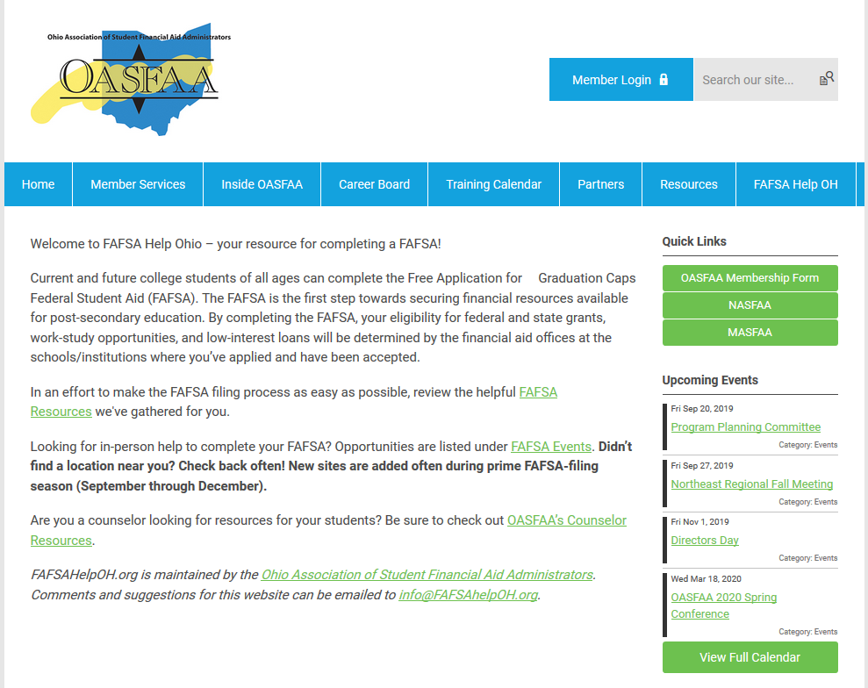
FAFSA HELP OHIO

Slide 61
RESOURCES FROM FEDERAL STUDENT AID
View and download resources from the office of Federal Student Aid (studentaid.ed.gov/sa/resources).
Publications, fact sheets, online tools, and other resources are available to help students prepare and pay for college.
Printed publications are no longer available from the U.S. Department of Education.
PDFs will continue to be available electronically.

Slide 62
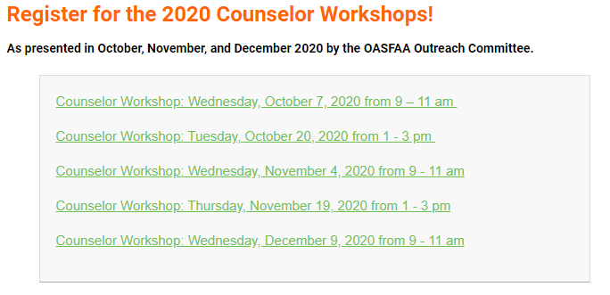
UPCOMING TRAINING FOR OHIO COUNSELORS
2020 High School Counselor Workshops REGISTRATION IS OPEN at www.oasfaa.org

Slide 63
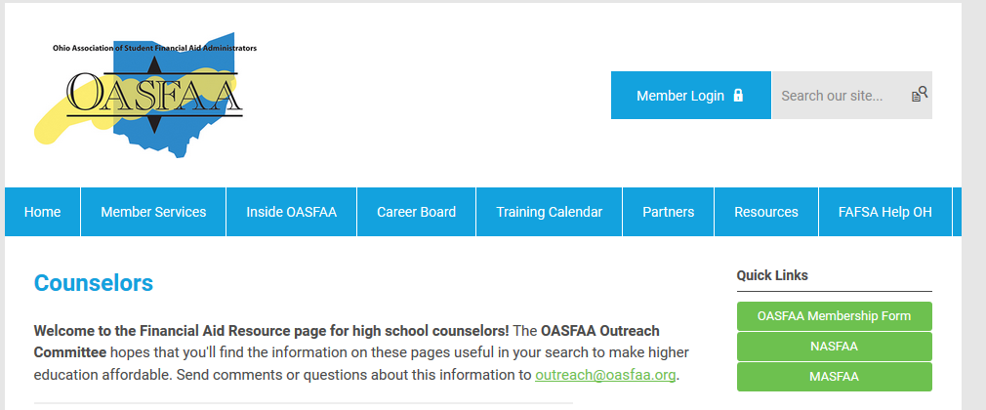
HIGH SCHOOL FINANCIAL AID NIGHTS
The OASFAA Outreach Committee can help facilitate your school’s Financial Aid presentation even virtually. If you would like a presentation, please complete a request for a presenter on the OASFAA website.

Slide 64
COLLEGE ACCESS AND SCHOOL COUNSELORS CONTACT DATABASE
Make sure you put your name and email address into our College Access and School Counselors Contact Database at www.oasfaa.org

Slide 65
QUESTIONS?
Thank you for attending the OASFAA Counselor Workshops.
Please complete the evaluation forms.
See you next year!

