Slide 1
2019 OASFAA COUNSELOR WORKSHOPS October and December 2019
Presenters: [TYPE NAMES HERE]

Slide 2
ABOUT OASFAA AND THIS PRESENTATION
OASFAA is a non-profit organization comprised of financial aid professionals. OASFAA Outreach is an all-volunteer committee
OASFAA has provided the information today as a free service to counselors
You have permission to copy and distribute these materials to your students and families. Charges may not be assessed for the material or for the information presented. Permission must be granted for other use of this information or these materials. Contact the OASFAA Outreach Chairperson(s) listed on the OASFAA website or e-mail the OASFAA Outreach Committee at: outreach@oasfaa.org

Slide 3
WORKSHOP AGENDA
FAFSA Updates
Federal Verification
Financial Aid Award Letters
Federal Aid Updates
State Aid Updates
Resources

Slide 4
FAFSA UPDATES FOR 2020-2021

Slide 5
FEDERAL STUDENT AID ID (FSAID)
https://fsaid.ed.gov
An FSA ID is a username and password that gives you access to Federal Student Aid’s online systems and can serve as your legal signature.
The student and one parent whose information is on the FAFSA will need their own individual FSA IDs.
The FSA ID (s) should be requested before beginning the FAFSA.
FSA ID requires an email address or mobile phone number. An email address and mobile number can only be associated with one FSAID. Parents and Students cannot use the same email or mobile phone number.
Note: Students or Parents with recycled cell phone numbers may need to reach out to an FSA Specialist
Do not use a high school email address because it will be deleted after graduation.
Notes:
Note: Cell phone carriers are beginning to recycle old cell phone numbers and assign them to new phones; Students or Parents with recycled cell phone numbers may need to reach out to an FSA Specialist if their recycled number is already associated with an FSA ID. They will not be able to proceed in obtaining an FSA ID unless they take this step.

Slide 6
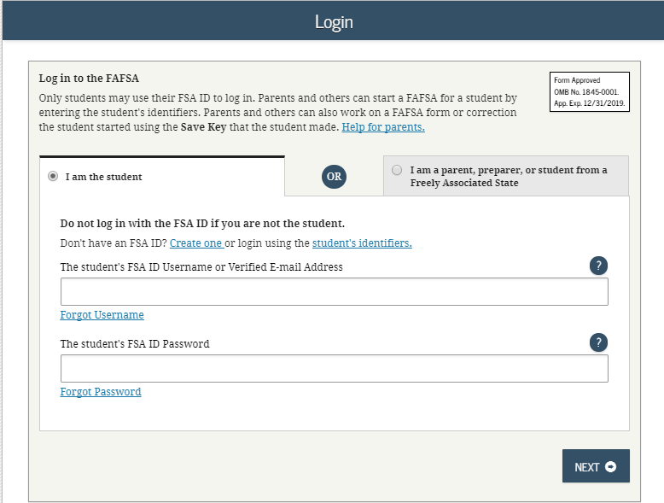
FOTW FAFSA On The Web
Notes:
Login makes it clearer for parents. The individual selects who they are “student” or “parent”

Slide 7
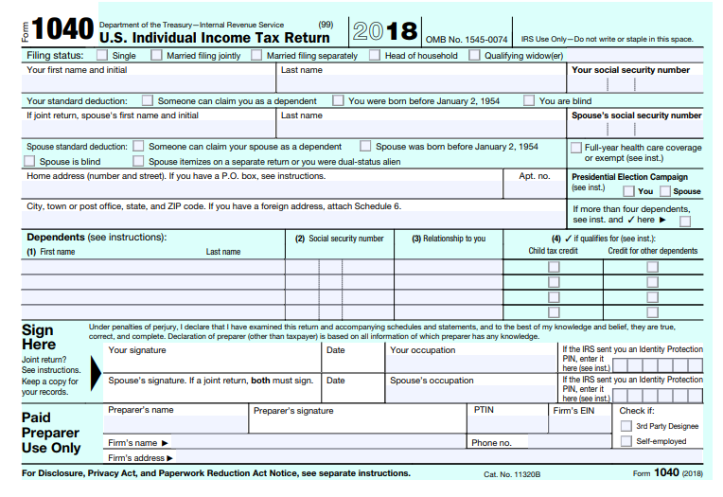
Changes to 2020-2021 FAFSA
Changes to the 2018 tax return are going to require changes to the FAFSA.
Notes:
This is a screen shot of the front side of the 1040 Form. Tell them the following things:
The new 1040 is now much shorter. Many questions were moved to the new Schedules 1-6.
The 1040A/EZ forms were eliminated.
The number of dependents question is gone off the tax form and therefore gone off the FAFSA.

Slide 8
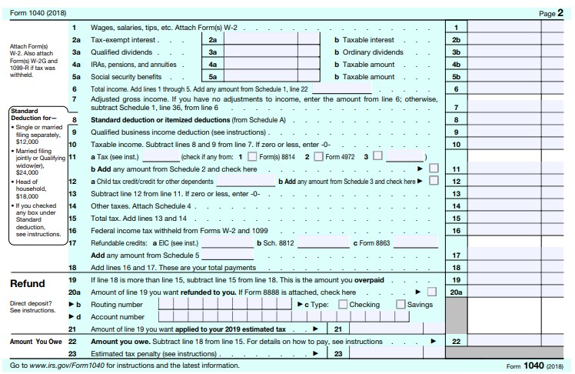
1040 Form Continued
Back of 1040 that is now much shorter than previous form.
Notes:
Highlight that question 4A is combined with IRA’s, pensions and annuities. This results in these questions being combined on the FAFSA.

Slide 9
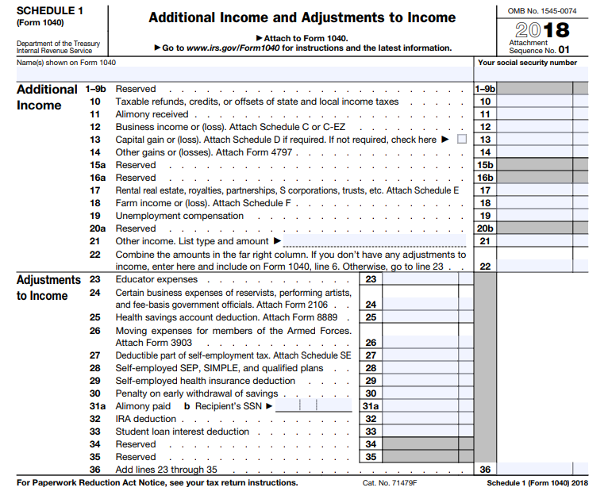
Schedule 1

Slide 10
CHANGES TO THE 2020-2021 FAFSA
Changes in the 1040 tax form will result in modified questions for the FAFSA
Several financial answers are now located on schedules instead of the main 1040 form
Order of questions on website more closely aligns with the mobile app
Student’s SSN will be masked at log-in on the website
IRS DRT will still be able to transfer those answers
IRS DRT will have mobile optimized screens this year
No longer a white signature box on mobile app

Slide 11
CHANGES TO THE 2020-2021 FAFSA
Elimination of 1040A/EZ resulted in removal of that question from the FAFSA
Replaced with “Did (or will) you file a Schedule 1 with your 2018 tax return?”
See FAFSA instructions on Page 9 for additional information regarding Schedule 1
This question now becomes part of the definition for Auto-zero EFC or Simplified Needs Test
If answer is no and you meet all criteria, student may qualify for Auto Zero EFC or Simplified Needs Test (fewer FAFSA questions to answer)
If answer is yes but you meet one of the 6 exemptions, you may still answer as no
This question will likely be confusing for families and may result in answering a few more questions if they responded “Yes” to the question

Slide 12
FAFSA UPDATES FOR 2020-2021
Number of Exemptions Claimed – no longer on the tax return
IRS combined untaxed portion of IRA and untaxed portion of pensions
Question is now combined on FAFSA and rollovers are still excluded
Minor adjustments to college grade level and college degree questions

Slide 13
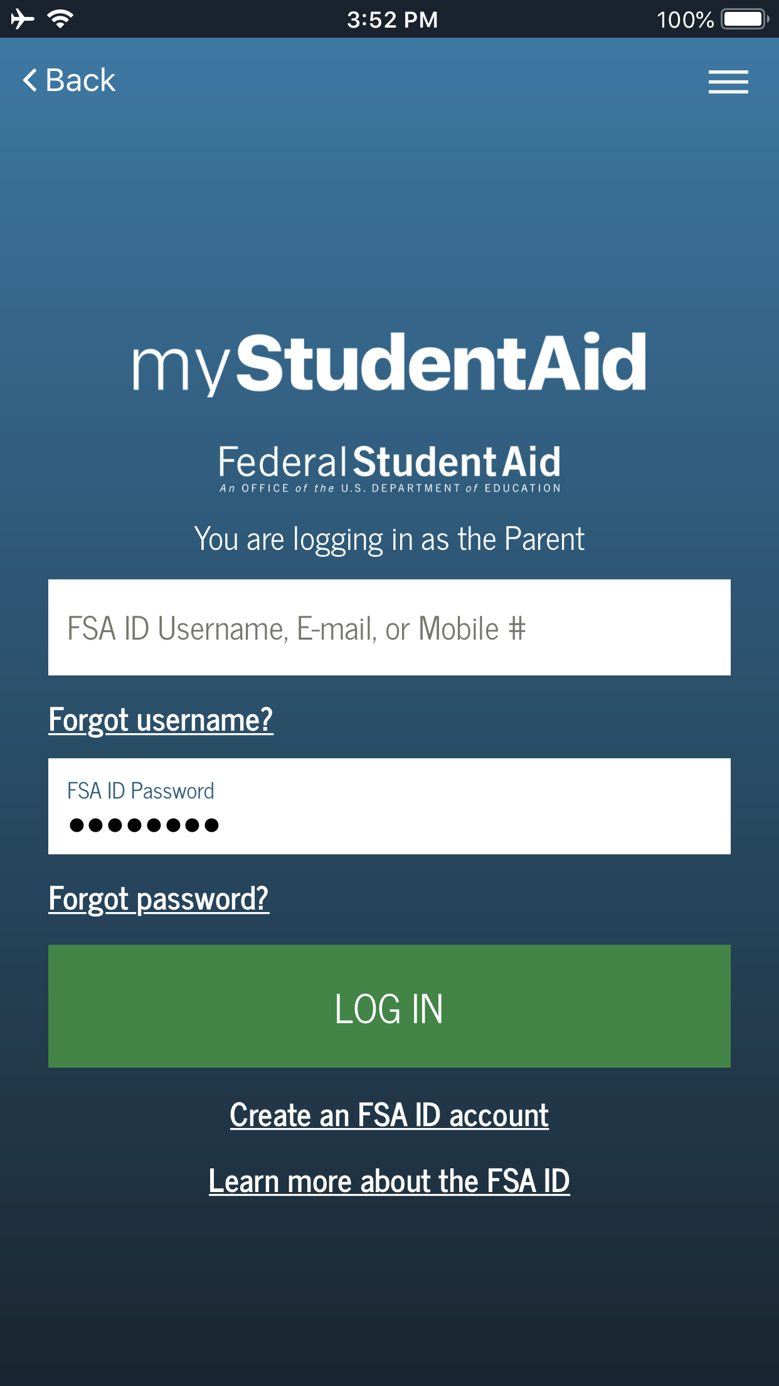
MOBILE APP UPDATES
Ready for Download: FAFSA® Completion on myStudentAid Mobile App
11% submitted a FAFSA via Mobile Optimized Option (phone or tablet)

Slide 14
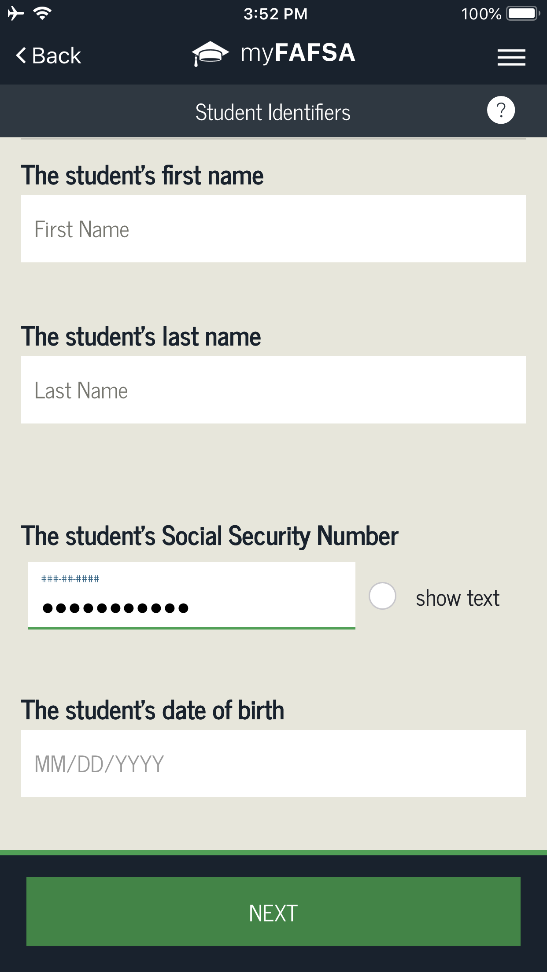
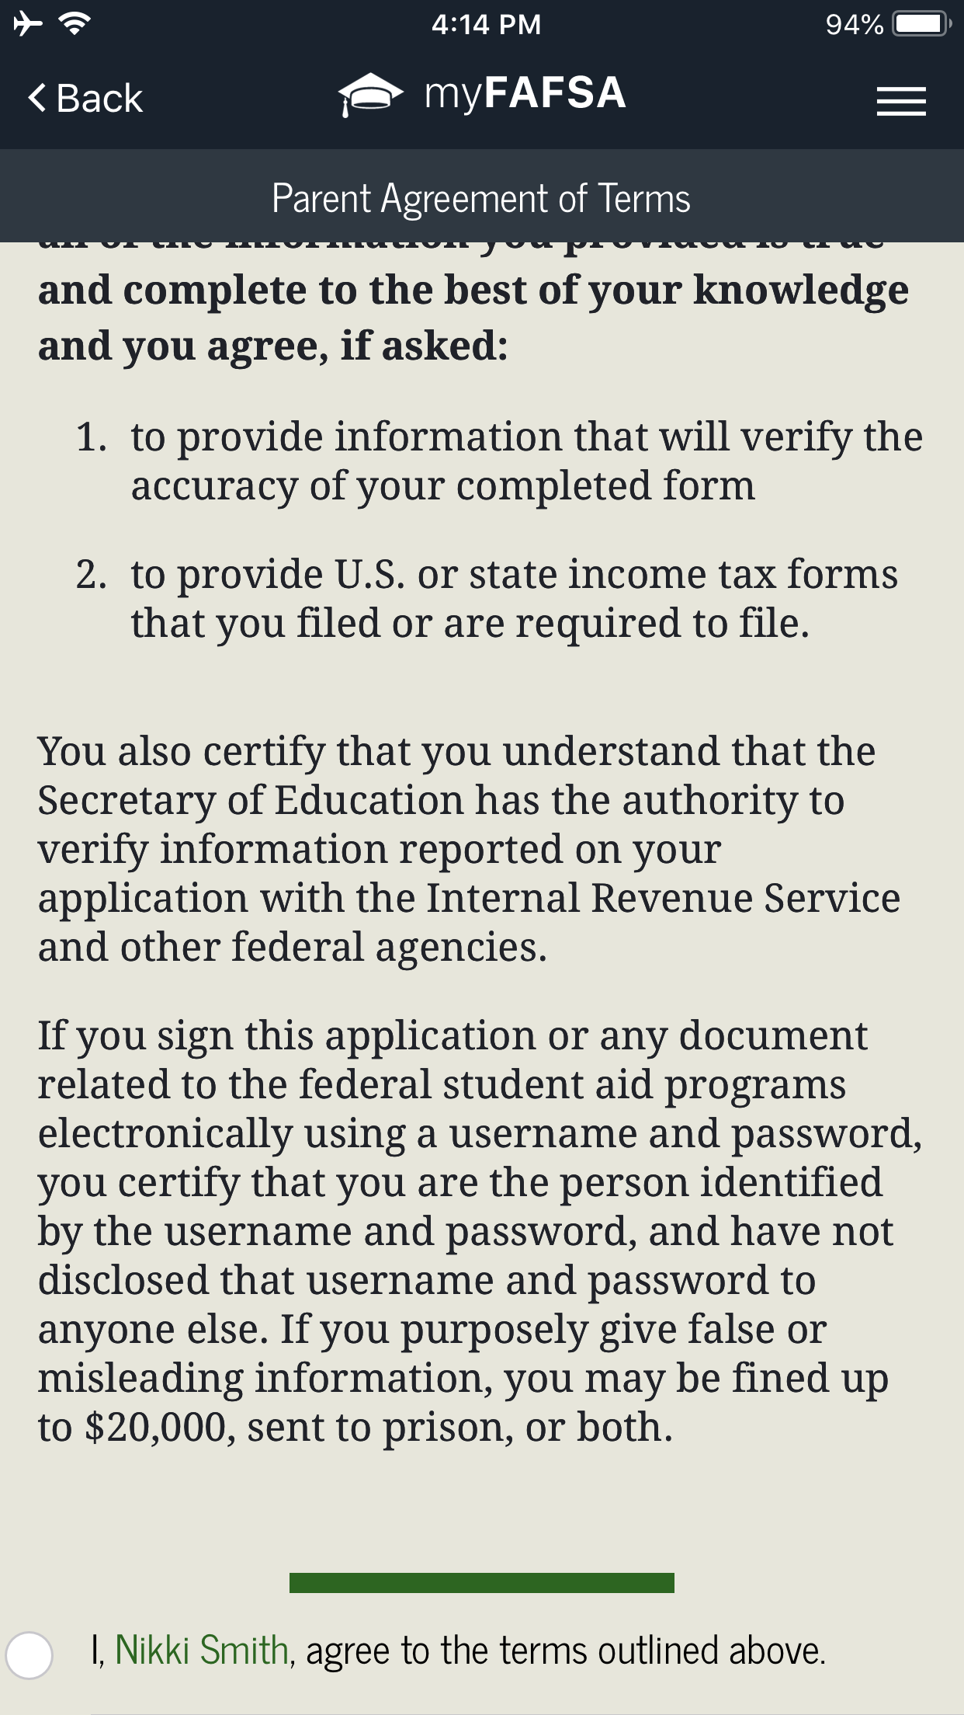
Edit text now role-based (i.e., the student’s first name).
Log In page updated with the role a user is logging in as.
Signature process updated from a swipe signature to a checkbox at the end of the terms and conditions.
Student’s SSN masked at login.

Slide 15
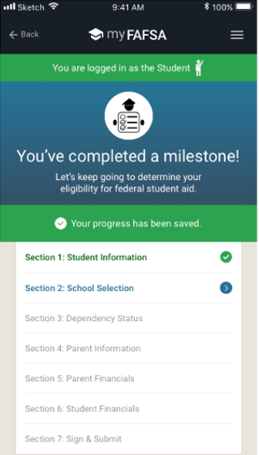
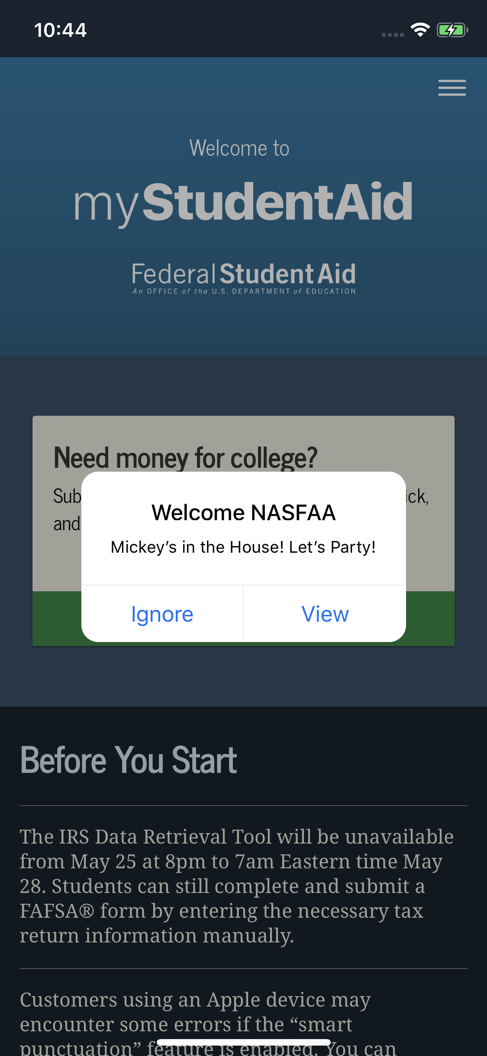
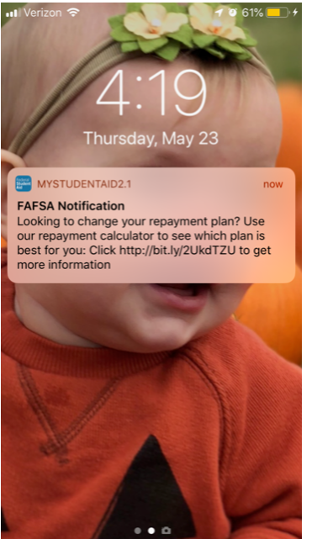
myFAFSA checklist shows the logged in user’s role.
Push notifications enabled.
School Search button renamed.

Slide 16
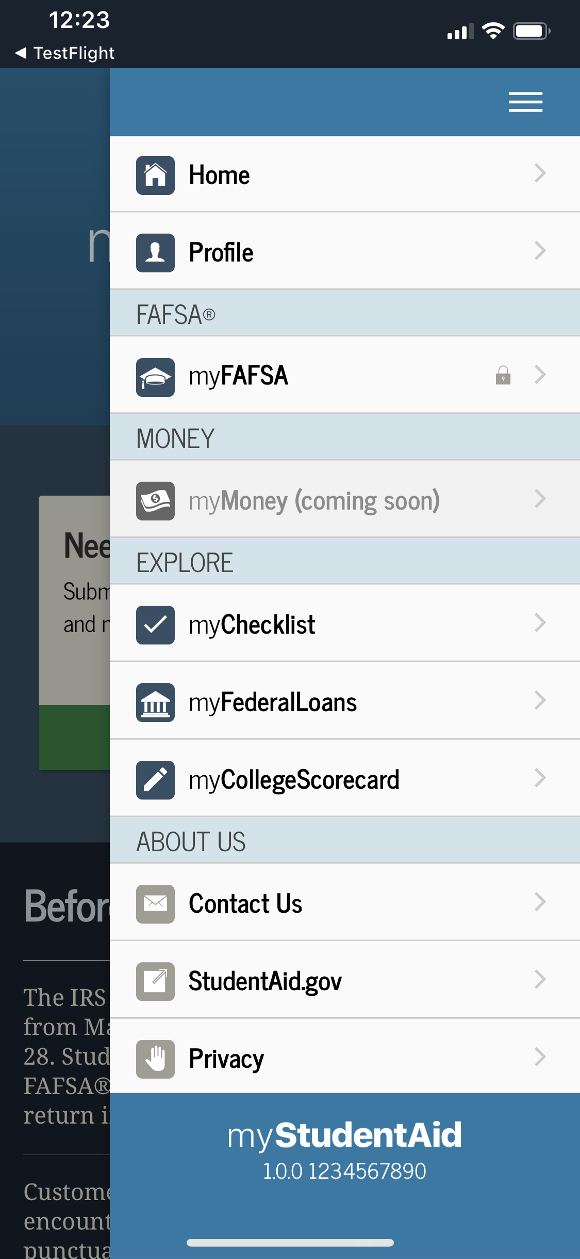
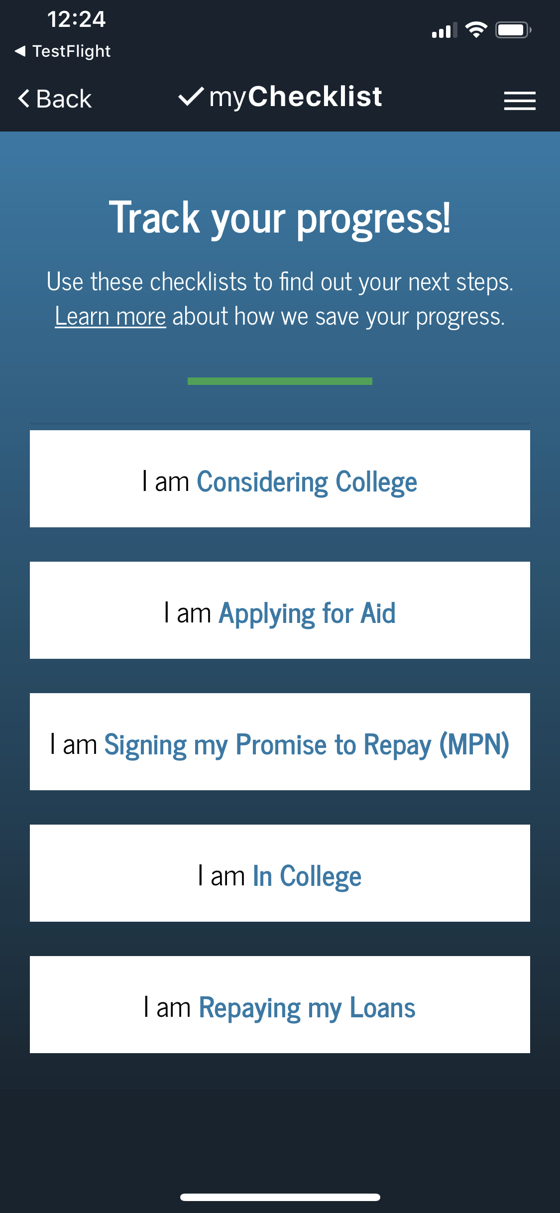
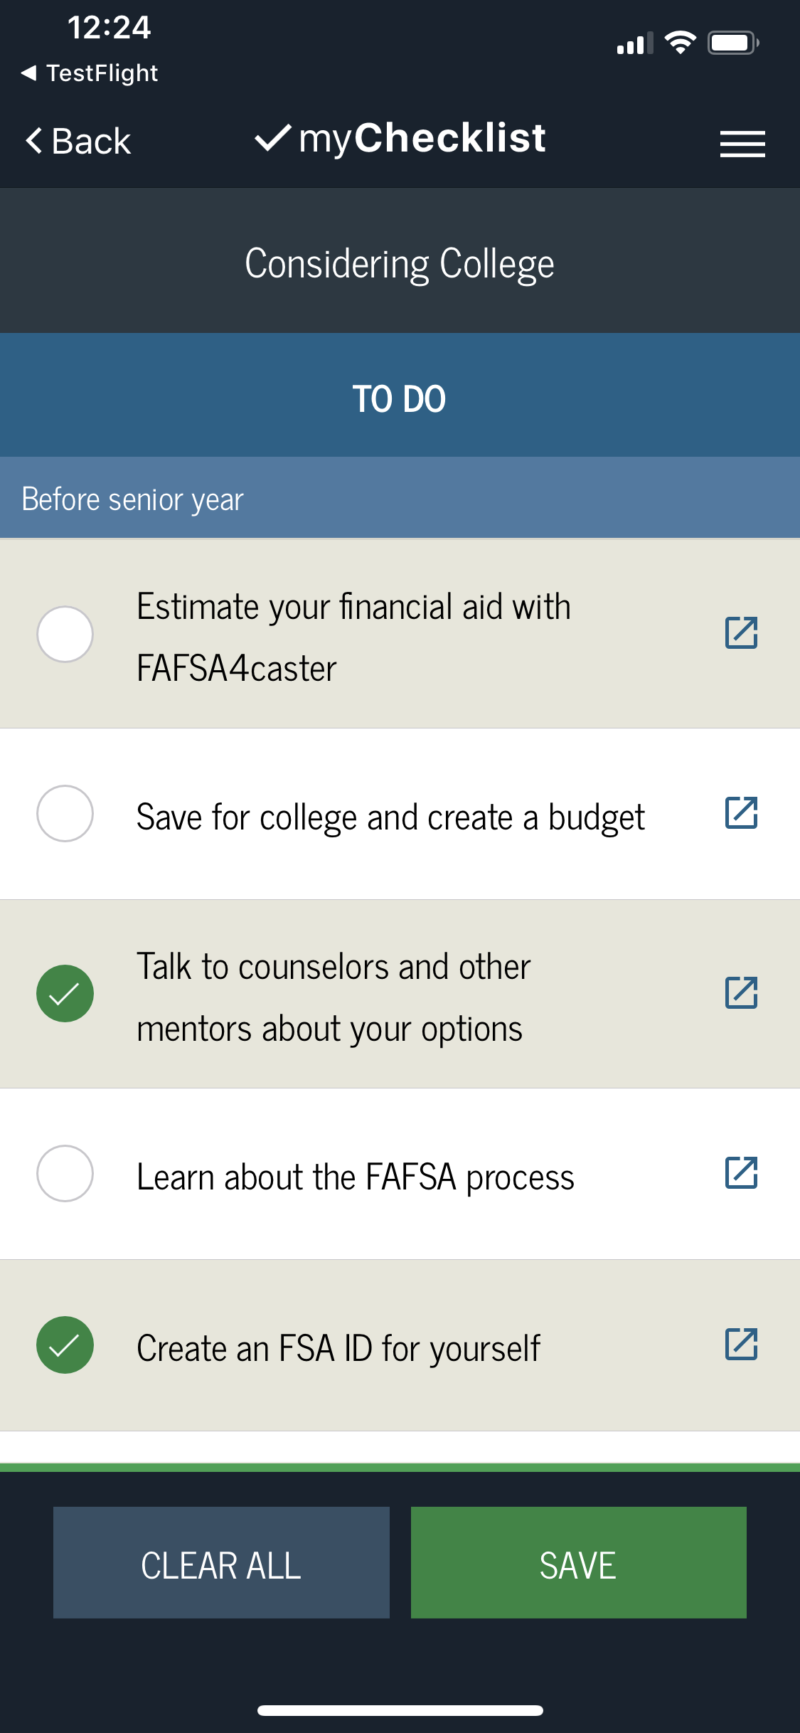
myChecklist provides users with guidance regarding student aid next steps.

Slide 17
FAFSA COMPLETION NUMBERS

Slide 18
NATIONAL/OHIO OVERVIEW OF FAFSA COMPLETIONS
End of June – Class of 2019 was down 0.4% compared to Class of 2018 at national level
Only 13 states had an increase this year
End of June – Ohio was down 3.1% compared to Class of 2018
End of June – Ohio has the 15th highest completion rate in the country with 60.9% of the Class of 2019 (74,889 FAFSAs)
End of August – Ohio has the 14th highest completion rate in the country with 65.7% of Class of 2019 (80,821 FAFSAs)
Almost 6,000 FAFSAs completed in July and August

Slide 19
NUMBER OF SCHOOLS LISTED ON FAFSA FORM
9%
16%
75%
Notes:
Notice the difference that difference between the number of colleges listed for freshmen versus upperclass. These numbers were through June 2019.

Slide 20
TRACKING FAFSA COMPLETION
To look at aggregate number and comparison options:
www.formyourfuture.org/fafsa-tracker
Compare this year versus last year at the state, city, district or building level
To look at student level data for Ohio: https://www.ohio-k12.help/fafsa/
Need Data sharing agreement signed by Superintendent
Site indicates that 2020-2021 FAFSA data will be available in early October
Do you get student level data at your school?
Notes:
Make sure the audience understands that the FAFSA tracker is aggregate numbers and for comparing the current year to the previous year. I am trying to get more info from ODHE on the process for getting student level data this year.

Slide 21
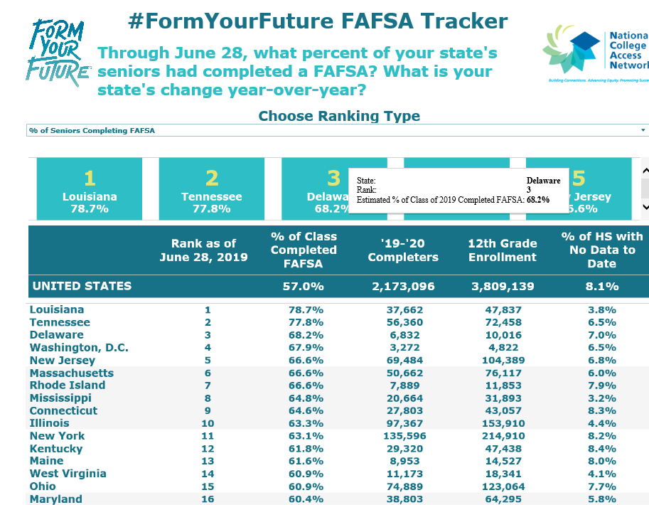
Notes:
This is a screen shot from the end of June for the Class of 2019. Ohio was 15th in FAFSA completion then with almost 61% of the Class of 2019. This chart is updated every Friday starting in October through June. Explore the website to see trends at the national, state, district and building level.

Slide 22
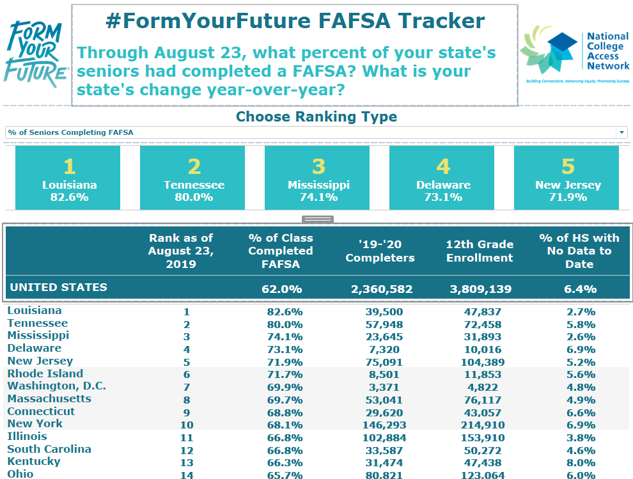
Notes:
Almost 6000 Ohio students completed a FAFSA between the end of June and late August.

Slide 23
FEDERAL VERIFICATION

Slide 24
VERIFICATION
Selection
Roughly 1/3 of FAFSAs get selected for verification by the U.S. Department of Education
If selected, commonly requested documentation includes:
Verification Worksheet (these can look different across varying colleges and universities)
Tax Return Transcript* for parents/student if they filed 2018 taxes or a signed copy of the 2018 income tax return
W-2(s) for parents/students if they worked in 2018 but didn’t file taxes
Verification of Non-Filing Letter for parents and independent students who did not file 2018 taxes – this is NOT needed for depended students
*If IRS DRT was used, Tax Return Transcripts are not required for that person

Slide 25
VERIFICATION
Federal Income Tax Return
Institutions may accept a signed copy of the federal income tax return for the applicable tax year that the tax filer submitted to the IRS or other relevant tax authorities (This includes a signed copy of the income tax return for amended tax filers and victims of identity theft)
Via online account creation or request to be mailed
Documentation
IRS Tax Return Transcripts can be requested at https://www.irs.gov/individuals/get-transcript or 1-800-908-9946
Via online account creation or request to be mailed
Can no longer have Tax Return Transcripts mailed to a third party (i.e. directly to the college or university)

Slide 26
VERIFICATION
Documentation (Continued)
Verification of Non-Filing Letters can be requested by completing an IRS Form 4506-T and faxing or mailing it to the IRS
Individuals who are unable to obtain verification of non-filing from the IRS or other relevant tax authority and, based upon the institution’s determination, may accept a signed statement certifying that the individual attempted to obtain the verification of non-filing from the IRS or other relevant tax authority and was unable to obtain the required documentation
For IRS extension filers, the signed statement must also indicate that the individual has not filed a 2018 income tax return and list the sources of any 2018 income, and the amount of income from each source

Slide 27
VERIFICATION ISSUES
“Will File” 2018 Taxes
If selected for verification…
School must verify that student/parent did file
Schools are only permitted to accept extensions beyond the standard 6-month extension
HEROES Act (Individual called upon for Active Duty or National Guard Duty) or
IRS Letter of Approval for extension beyond 6-months
If not federally selected, a school may choose to institutionally select the FAFSA for verification.

Slide 28
VERIFICATION ISSUES
Head of Household
If married, parents cannot file taxes with a Head of Household filing status. However, an exception to this general rule exists…
If parents are “considered unmarried” they can file Head of Household
While not the only requirement to be “considered unmarried,” parents cannot be living or have lived in the same household for the last 6-months (of the tax year)
Marital Status: As of the date the FAFSA is completed.
Tax Filing Status: As of December 31, 2018

Slide 29
VERIFICATION ISSUES
Head of Household
Financial Aid administrators are not required to be tax experts; however, the Dept of Education requires that FAAs know the requirements of filing statuses and when an individual can and cannot file as Head of Household
If it is identified that a parent filed HOH erroneously, they must amend their 2018 taxes for their student to receive federal aid

Slide 30
VERIFICATION QUICK REFERENCE CHART
For students and parents who did not file and are not required to file a federal tax return:
*Must indicated did not file and not required to file as well as include source and amounts of income earned from work
**From each source of 2018 income earned from work
Who | Signed Statement Required* | Copies of W-2s Required** | Confirmation of Non-Filing from IRS Required
Dependent Student | Y | Y | N
Independent Students | Y | Y | Y
Parents of Dependent Students | Y | Y | Y

Slide 31
FINANCIAL AID AWARD LETTERS Comparison of aid and costs

Slide 32
FINANCIAL AID AWARD LETTERS
After being accepted to college and completing the FAFSA, students will receive a letter that outlines how much the school will cost and the financial aid they will receive
This will often include federal, state, and school sources of financial aid
While there’s no standard format for an award letter, they typically contain the same overall information:
An estimate of how much a student’s year in college will cost
The financial aid that has been awarded for the academic year
Remaining balance (gap) that may be covered through other sources, if any

Slide 33
FINANCIAL AID AWARD LETTERS
To determine if a family is eligible for aid, they must complete the Free Application for Federal Student Aid (FAFSA) at www.fafsa.gov
Families can apply starting October 1, 2019 for the 2020-2021 academic year
Once the FAFSA is completed, the U.S. Department of Education will send the student a Student Aid Report (SAR)
The SAR summarizes the data from the FAFSA and indicates the Expected Family Contribution (EFC)

Slide 34
FINANCIAL AID AWARD LETTERS
To determine the financial aid award, a school subtracts the EFC from the cost of attendance (COA) to determine the student’s financial need
The financial aid awards take into consideration several factors including the cost of attendance, family income, family size, number of family members in college
Please note that some schools also require filing of the College Board PROFILE (www.collegeboard.come/profile)

Slide 35
FINANCIAL AID AWARD LETTERS
Why are award letters so confusing?
Delivery methods vary among colleges and universities – paper version, email version, online portal version, etc.
Formatting variations
Schools rarely use the same template/layout
Language variations
Sub Loan, Direct Sub Loan; Federal Direct Subsidized Loan: what’s the difference?

Slide 36
FINANCIAL AID AWARD LETTERS
Why are award letters so confusing? (Continued)
Are the awards automatic, or require additional action? If so, what action is needed?
How clear are the parameters on the letter?
Does the school provide information on the letter? Supplemental document with guidance? Call to action/next steps?
How does the school deal with Federal Work Study, Parent PLUS Loan, Private Education Loans, and/or Income Share Agreements?
Are there charges on the letter?
If so, are they estimated or actual?
Do they include only direct charges, or direct and indirect charges?

Slide 37
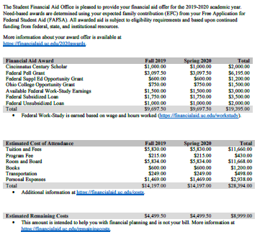
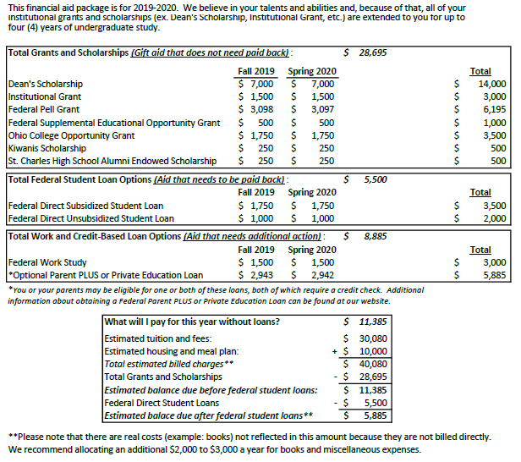
Two award letters, two different types of institutions, two different layouts
Notes:
This slide illustrates the difference in two different award letters. The letter on the left is from a four-year public institution, and the one on the right is modeled after an actual award letter from four-year private institution. Let’s break them down and show that, even though they largely give the same information, they are laid out in very different ways. Both have their pros and cons. The first (public) is not nearly as busy, and does a good job of spelling out the estimated cost of attendance through an itemized list. The second is busy, but does a good job of spelling out the aid offers in a segmented manner, making it easier to discern the different types of aid, and how much they are. It does not, however, do as good of a job of spelling out the cost of attendance.

Slide 38
GIFT AID (SCHOLARSHIPS & GRANTS)
Gift aid (scholarships and grants) are exactly that: they’re a GIFT!
Free money that does not need to be repaid
May be renewable or non-renewable
Scholarships
Tend to be based on academic merit or special talent (performance, athletic)
Primary Source is the School or institution itself
Can be funded or unfunded
Secondary sources are 3rd party philanthropic and state organizations
Scholarships rarely come from the federal government

Slide 39
GIFT AID (SCHOLARSHIPS & GRANTS)
Grants
Often based on financial need and can come from the institution, state, or federal government
Federal Grants
Federal Pell Grant (Pell)
Federal Supplemental Educational Opportunity Grant (SEOG or FSEOG)
State Grants
Ohio College Opportunity Grant (OCOG)
Pennsylvania Higher Education Assistance Agency (PHEAA) Grant

Slide 40
FEDERAL STUDENT LOANS
Notes:
One of the things I like about both award letters is that they both clearly identify grants and scholarships, and also list the awards by both term and academic year. The second example makes it easier to discern grants and scholarships from other aid by putting it in its own area, in this case a box, on the “college financing plan”.

Slide 41
GIFT AID (SCHOLARSHIPS & GRANTS)
Common gift award names and iterations
Federal Pell Grant
Pell, Pell Grant
Federal Supplemental Educational Opportunity Grant
Supplemental Educational Opportunity Grant, SEOG, FSEOG
Federal TEACH Grant
TEACH, TEACH Grant
Ohio College Opportunity Grant
OCOG
Pennsylvania Higher Education Assistance Agency Grant
PHEAA, PHEAA Grant
Helpful hint!
If the award description says scholarship or grant, it’s free money!

Slide 42
FEDERAL STUDENT LOANS
Notes:
Again, both do a good job of identifying the different types of loans, but they do it in a different way. With that being said, one uses the full loan name, and the other an abridged name. What’s the difference? Is there a difference?

Slide 43
FEDERAL STUDENT LOANS
Federal student loans are provided by the government and must be paid back with interest.
They have a fee that is deducted from the total loan proceeds before they are applied to the student’s college or university account.
Students must complete the FAFSA to be eligible for federal student loans.
Common Federal Student Loan names and iterations:
Federal Direct Subsidized Stafford Loan
Federal Direct Subsidized Loan, Fed. Sub. Loan, Sub. Stafford Loan, Direct Sub. Loan, Sub. Loan
Federal Direct Unsubsidized Stafford Loan
Federal Direct Unsubsidized Loan, Fed. Unsub. Loan, Unsub. Stafford Loan, Direct Unsub. Loan, Unsub. Loan

Slide 44
WORK STUDY AND CREDIT-BASED LOAN OPTIONS
Notes:
Again, both do a good job of identifying work study, but both require an addendum to spell out what work study actually is. The second does a good job of letting you know that the things in this box need additional action. The second also packages optional, credit based loans, and gives supplemental information directly below the box.

Slide 45
WORK STUDY AND CREDIT-BASED LOAN OPTIONS
Work Study
The Federal Work Study Program provides students who need additional financial aid with part-time jobs to earn money to help pay for college expenses.
Most of the jobs the program offers are paid on an hourly basis and are usually on campus.
To qualify for Federal Work Study assistance students must file the FAFSA.
Important note: Work Study funds are not applied to the student’s bill! They are paid to the student via a paycheck.
Notes:
How the work study program works varies by school. Make sure to find out if the school will find you a job or if there’s an application process you need to follow. Also note that while most positions are on campus, there are some that are in the college community (community service type positions)

Slide 46
WORK STUDY AND CREDIT-BASED LOAN OPTIONS
Credit-based Loan Options
Parent PLUS Loan
Federal Loan program where the loan is in the parent’s name, parent is solely responsible for the loan
Fixed interest rate, various repayment terms
Private Education Loan
Education loan through a private lender
Student is the primary borrower; co-signer may be required
Fixed or variable interest rate and repayment terms; both will vary based on lender
Notes:
How the work study program works varies by school. Make sure to find out if the school will find you a job or if there’s an application process you need to follow. Also note that while most positions are on campus, there are some that are in the college community (community service type positions)

Slide 47
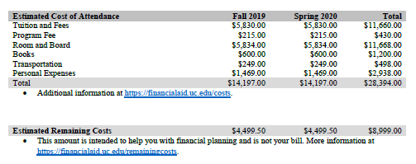
ESTIMATED COST OF ATTENDANCE & REMAINING COSTS
Notes:
Different layouts; similar information. The first example does a good job of spelling out the estimate of each individual expense, both direct and indirect, while the second only lists direct expenses, and has an asterisk telling you that there are an additional $2,000-$3,000 in indirect expenses not accounted for on the offer sheet. Again, pros and cons to each. The first does a good job of letting you know ALL of your expenses, but also represents Work Study as money that is applied to your bill, which is not the case. The second does a better job of representing how much it will cost you after gift aid, and again after federal loans, but does not include indirect costs. Neither factor in origination fees for federal student loans.

Slide 48
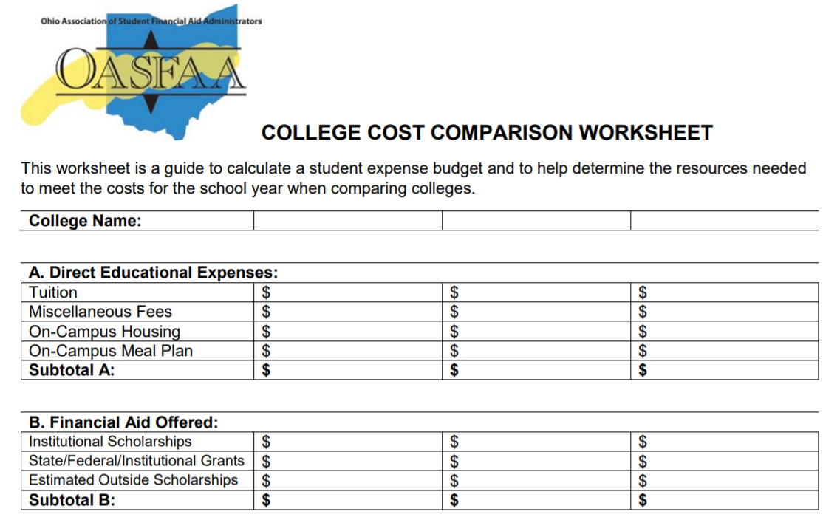
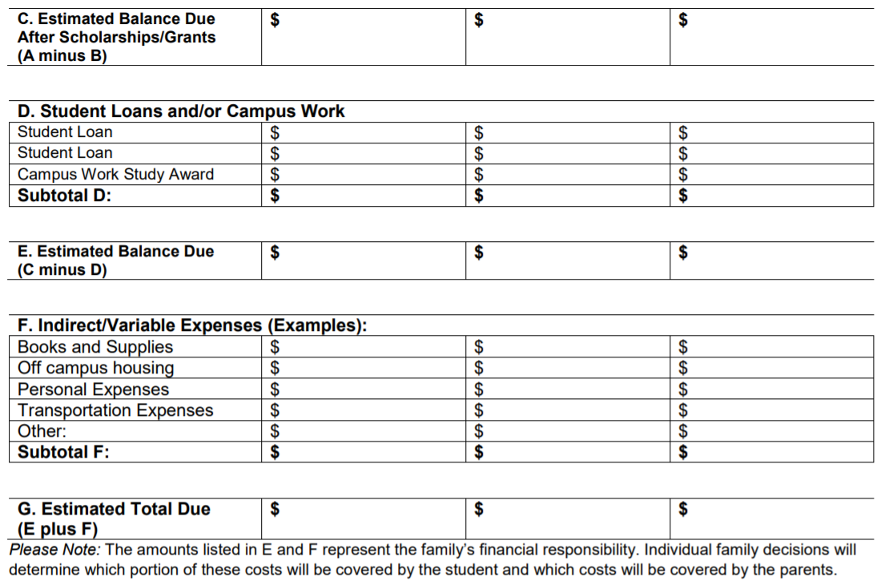
Comparison Tools
There are some great, free tools available!
OASFAA College Cost Comparison Worksheet:
https://www.oasfaa.org/assets/docs/CostAndFinancialAidComparisonWorksheet.pdf
Notes:
****Note: Counselors sometime ask about students’ and families’ ability to “negotiate” financial aid awards or offers with colleges and universities. While most institutions typically award their best financial aid offer upfront with little to no room for negotiation, there could be options for some families at some institutions in terms of receiving an updated award offer, including special circumstances appeals, applications for additional institutional scholarships or grants, or agreeing to participate in certain programs (i.e. honors, etc.)***

Slide 49
FEDERAL AID PROGRAMS
Pell Grant
TEACH
Campus Based Programs
Direct Loans

Slide 50
FEDERAL PELL GRANT 2019-2020
Maximum award amount increased slightly for 2019-2020
$6,195 maximum award for full-time enrollment and an Expected Family Contribution (EFC) of zero
Maximum Expected Family Contribution (EFC) for Pell eligibility increased to 5576 for 2019-2020; it has not yet been established for 2020-2021

Slide 51
FEDERAL PELL GRANT 2019-2020
Students have a maximum number of terms they can receive Pell Grant
600% of an annual award amount, or the equivalent of 12 full time semesters
Year-round Pell Grants remain
Students can attend on a year-round basis and receive up to 150% of their annual award
Serves as an incentive to complete the credential/degree
Still have the 12 full time semester limit
Notes:
Remind attendees of 600% Pell limit and the importance of encouraging students to clearly define their academic plans to accelerate their time to degree completion prior to running out of Pell funds. A student who consistently withdraws from courses or changes their major could conceivable hit the 600% limit and not finish their degree by receiving Pell funds for those courses they have to retake (withdrawals) or for courses that were in an original major that are not required for the new major.

Slide 52
TEACH GRANT 2019-2020
For any 2019–20 TEACH Grant first disbursed on or after Oct. 1, 2019, and before Oct. 1, 2020, the maximum award of $4,000 is reduced by 5.9 percent ($236)
Grant of up to $3,764 per year to students who intend to teach in a public or private elementary or secondary school that serves students from low-income families
Service requirement upon graduation must be met, or grant becomes an Unsubsidized Direct Loan that must be re-paid!

Slide 53
CAMPUS BASED PROGRAMS 2019-2020
Can vary significantly in amount between colleges & universities.
“Priority Deadlines” can impact eligibility between schools.
For most schools, FWS earnings are given in paycheck form and not applied directly to the student’s bill.
Federal Supplemental Education Opportunity Grant (SEOG)
Federal Work-Study
Notes:
Allocations vary from school to school.

Slide 54
FEDERAL WORK-STUDY (FWS)
Undergraduate or graduate students are eligible
Employment can be on or off campus
FWS wages are excluded from EFC calculation
Ohio Minimum Wage in 2019 is $8.55/hour
There is a difference between work study and “work” or “employment” on an award letter
Notes:
While this is rare, some schools will list an arbitrary “work” award. Stress the difference between work study and “work” or “summer job”-, i.e. some schools are putting “summer income, $2,000,” on the award letter basically suggesting that students get a job.
Students must work their maximum number of allowed hours in order to earn their full work study award.
In most cases, FWS earning are not applied directly to the students bill but earned through a paycheck like any other employment.
*while FWS earning are excludable, earnings from a freshman’s fall semester (2019) won’t be reported till the 2021–2022 award year (the student’s junior year) and earnings from a freshman’s spring semester (2020) and subsequent sophomore fall (2020) won’t be reported till their senior year (2022–2023)”

Slide 55
FEDERAL SEOG
Undergraduates with exceptional financial need
(Pell Eligible students with the lowest EFC).
Award ranges from $100 to $4,000, depending on when student applies, financial need, and the funding and policies of school attending.
Notes:
No changes.

Slide 56
DIRECT LOANS: UNDERGRADUATE 2019-2020
Direct Subsidized and Unsubsidized Loans are two separate, unique types of loans that are awarded separately.
Subsidized Undergraduate | Unsubsidized Undergraduate
Need based | Not based on financial need
Interest is fixed at 4.53% for new undergraduate loans disbursed during 2019-20*; interest is subsidized while the student is in school and during deferment. | Interest is fixed at 4.53% for all new loans disbursed during 2019-20*; interest accrues from time of disbursement of the funds.
*Interest rates recalculated annually and are effective July 1st based on the 10-year treasury note index plus 2.05%, capped at 8.25%
Notes:
Subsidized Loan-interest is deferred ONLY during periods of half-time or more enrollment.
Direct Loans also feature origination fees that are deducted from each loan disbursement. For Direct Subsidized and Unsubsidized loans disbursed on or after 10/1//19 and before 10/1/20, the origination fee is 1.059%.

Slide 57
DIRECT LOANS 2019-2020 (NO CHANGES)
Class Year | Maximum Subsidized Amount | Additional Unsubsidized Amount | Total Available to Borrow
Freshman | $3,500 | $2,000 | $5,500
Sophomore | $4,500 | $2,000 | $6,500
Junior | $5,500 | $2,000 | $7,500
Senior | $5,500 | $2,000 | $7,500
For Undergraduates, Independent Students and Dependent Students whose parents have been denied the PLUS Loan are eligible for additional Direct Unsubsidized Loans ($4,000 as Freshmen and Sophomores and $5,000 as Juniors and Seniors)
Notes:
Stress that the student’s must have demonstrated financial need to have subsidized loans. A freshman with a $100,000 EFC will still get the total $5,500 in loans, but it will all be unsubsidized.

Slide 58
DIRECT LOANS: GRADUATE 2019-2020
Graduate students are only eligible for Unsubsidized Loans (not subsidized)
Unsubsidized Graduate
Not based on financial need
Interest is fixed at 6.08% for all new loans disbursed during 2019-20*; interest accrues from time of disbursement of the funds
Did you know?
Graduate students have higher loan limits than Undergraduate Students as they can borrow $20,500 annually
*Interest rates recalculated annually and are effective July 1st based on the 10-year
Treasury note index plus 3.60%, capped at 9.5%

Slide 59
INCOME-DRIVEN REPAYMENT PLANS
There are now four income-driven repayment plans:
Income Contingent Repayment (ICR)
Income-Based Repayment (IBR)
Pay As You Earn (PAYE)
Revised Pay As You Earn (REPAYE)
These plans are designed to give students peace of mind related to the affordability of their student loan payments.
Notes:
Details on these plans is beyond the scope of this presentation (it would be easy to spend 45 minutes just on these programs). The basic premise is that payment is based on your income, not on your loan balance, interest rate and repayment term (as with most all other types of loans).

Slide 60
PUBLIC SERVICE LOAN FORGIVENESS
Under this program, borrowers may qualify for forgiveness of the remaining balance of their Direct Loans after they have made 120 (10 years worth of) qualifying payments on those loans while simultaneously employed full time by certain public service employers and/or any non-profit employer.
Only loans borrowers received under the William D. Ford Federal Direct Loan (Direct Loan) Program are eligible for PSLF.
There are many rules that must be followed.
Notes:
This program continues to be offered and is unchanged for 2019-2020.
Keep this very high level, just making counselors aware of a program that is getting more and more media and department of education attention.

Slide 61
FEDERAL PARENT PLUS LOAN
Parent PLUS
Loan to parents of dependent students
Loan limits are up to the cost of education less any financial aid received
Interest rate is 7.08% fixed*
Repayment begins within 60 days of full disbursement; payments may be deferred while the student is in school
FAFSA completion is required
*Interest rates recalculated annually and are effective July 1st based on the 10-year Treasury note index plus 4.6%, capped at 10.5%
Notes:
Regarding when repayment begins, explain that this is all decided by the parent when they are completing the application. It simply asks them if they would like the payments deferred while the student is in school and if they would like a 6-month grace period.
Direct PLUS loans also have an origination fee that is deducted from each disbursement of the loan. For disbursements on or after 10/1/19 and before 10/1/20, the origination fee is 4.236%.

Slide 62
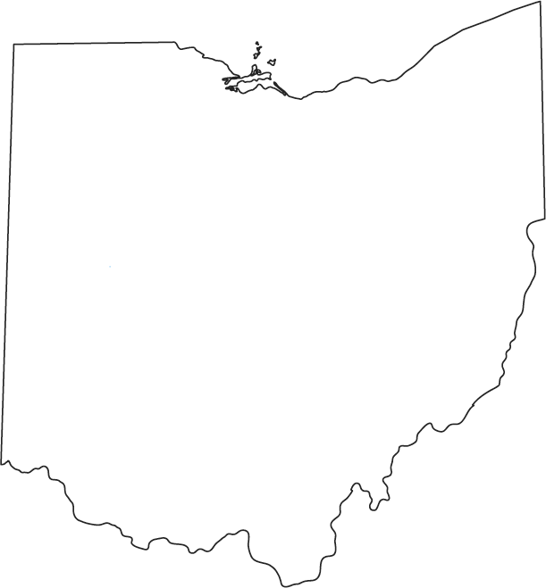
STATE AID PROGRAM UPDATES
Ohio College Opportunity Grant (OCOG)
Nurse Education Assistance Loan Program (NEALP)
War Orphan & Severely Disabled Veterans’ Scholarship
National Guard Scholarship
Safety Officers Memorial
Choose Ohio First

Slide 63
OHIO COLLEGE OPPORTUNITY GRANT (OCOG)
To be eligible for OCOG a student must:
File the FAFSA AND
Be an Ohio resident AND
Attend an Ohio public university’s main campus OR
Attend an Ohio private, non-profit college or university OR
Attend an Ohio private, for-profit institution
Notes:
FAFSA deadline for OCOG is October 1 of each year for which the student is receiving aid.
Point out the Ohio’s deadline is October 1, 2020 .

Slide 64
OHIO COLLEGE OPPORTUNITY GRANT (OCOG)
The Expected Family Contribution (EFC) is the index number for awarding OCOG
EFC eligibility range is from 0000-2190 AND a maximum household income of $96,000
A part-time student will receive a pro-rated award
Eligible students continuously enrolled may receive an additional 1/2 or 1/3 of their respective award amount in their third semester or fourth quarter
Students are limited to 10 semesters or 15 quarters of state, need-based grant aid (including combination of OCOG and OIG)
Notes:
Household income of $96,000 or less.

Slide 65
Ohio College Opportunity Grant (OCOG)
2019-2020 Awards | ENROLLMENT STATUS
 | FULL-TIME | 3/4 TIME | 1/2 TIME | 1/4 TIME
PUBLIC INSTITUTIONS
Community Colleges* | 0 | 0 | 0 | 0
Regional Campuses* | 0 | 0 | 0 | 0
All Other Main Campuses | 2,000 | 1,500 | 1,000 | 500
PRIVATE & NON-PROFIT INSTITUTIONS
Private, Non-Profit | 3,500 | 2,625 | 1,750 | 875
Private, For-Profit | 1,300 | 975 | 650 | 325
Pennsylvania Institutions | 600 or 800 | 300 or 400 | 300 or 400 | 0
Notes:
Amount of OCOG for 2019-20 for full-time students at most public institutions: $2000
Amount of OCOG for 2019-20 for full-time students at most private, non-profit institutions: $3500
Amount of OCOG for 2019-20 for full-time students at eligible private, for profit institutions:$1300
Eligible students attending a community college or regional campus year-round who have exhausted their Pell grant for the year, may be eligible for a main campus term award for the third-term.
Mention that ETV is the Ohio Education and Training Voucher Program.

Slide 66
THIRD-TERM OCOG
For students attending year-round at a public community college, regional campus, or an institution with an adjusted award amount, statute states that an OCOG award may be distributed for the third-term of the academic year, once Pell grants have been exhausted for that year.
This exception is only for students that are Pell eligible.
All other OCOG eligibility requirements remain.
Note: with the recent implementation of year-round Pell grants, an institution may find less students that would qualify for third-term OCOG.
Notes:
The fixed Pell/EFC combo of $6,195 continues to exceed the average tuition and general charges at community colleges and therefore, consistent with past practice, no OCOG awards will be available to students attending these institutions unless they otherwise qualify for foster youth status, Federal Veteran’s Education benefits, or third-term OCOG. These students may be eligible for up to the public main campus award amount.

Slide 67
AWARDS CHARTS FOR THIRD-TERM 2019-2020
*Based on full-time (FT) enrollment status
Public Institutions | 1st Term* | 2nd Term* | 3rd Term*
Community Colleges | $0 | $0 | $1,000
Regional Campuses | $0 | $0 | $1,000
*Based upon three-fourth-time (TT) enrollment status
Public Institutions | 1st Term* | 2nd Term* | 3rd Term*
Community Colleges | $0 | $0 | $750
Regional Campuses | $0 | $0 | $750
Notes:
The fixed Pell/EFC combo of $6,195 continues to exceed the average tuition and general charges at community colleges and therefore, consistent with past practice, no OCOG awards will be available to students attending these institutions unless they otherwise qualify for foster youth status, Federal Veteran’s Education benefits, or third-term OCOG. These students may be eligible for up to the public main campus award amount.

Slide 68
OCOG AWARDS
For Community Colleges and Regional Campuses:
The fixed Pell/EFC combo of 6195 continues to exceed the average tuition and general charges at community colleges and therefore no OCOG awards will be available to students attending these institutions unless they otherwise qualify for foster youth status, Federal Veteran’s Education benefits, or third-term OCOG.
Notes:
Eligible foster youth at community colleges may qualify for OCOG using main campus award amounts.
*Eligible students receiving federal veterans’ education benefits at community colleges and regional campuses may qualify for OCOG using main campus award amounts.
*Eligible students attending a community college or regional campus year-round who have exhausted their Pell grant for the year, may be eligible for a main campus term award for the third-term.
** Tuition level/costs are the determining factors in receipt of an OCOG award and therefore students at these institutions have an adjusted OCOG award amount. If the student attends year-round, they may be eligible for an award up to the public or private, non-profit award amount for their third term once Pell grants have been exhausted for the academic year.

Slide 69
FOSTER YOUTH AT COMMUNITY COLLEGES
Qualified foster youth at community colleges continue to be eligible for OCOG for 2019-2020. Statute requires that for otherwise OCOG eligible students, their living expenses are to be added to their tuition/general fees to determine their OCOG award amount.
Qualified foster youth should receive a letter from the Ohio Education and Training Voucher (ETV) Program that lists their ETV award.
Could be eligible for the 2019-2020 maximum public OCOG amount of $2,000.

Slide 70
NURSE EDUCATION ASSISTANCE LOAN PROGRAM
(NEALP)
Loans for RN candidates and graduate nurse faculty students
Recipients must serve as a full-time nurse in Ohio for 5 years to qualify for 100% loan cancellation
Annual award for most recent academic year: $1,620/year OR $6,000/year for Masters of Nurse Education
Notes:
NEALP application period runs from January 1st to July 15th each year. Must be enrolled for at least half-time study (or accepted for enrollment) in approved Ohio pre-licensure nurse education program who intend to serve as nurses after graduation
Note: Due to limited funding available and the continued abundance of practicing LPNs, NEALP will once again make awards for the 2019-2020 academic year only to RN and nurse instructor candidates. View NEALP information on Ohio Higher Ed website: https://www.ohiohighered.org/nealp
Steps to Apply
Complete the Free Application for Federal Student Aid.
Go tohttps://nealp.ohiohighered.org/pg_1?::::: and follow the instructions to complete the NEALP application process. Students must create a NEALP Web Account as a new user. (Please Note: NEALP does not automatically renew; students need to reapply annually)
Feel free to call 614-466-3561 with any questions or e-mail nealp_admin@highered.ohio.gov

Slide 71
OHIO WAR ORPHAN & SEVERELY DISABLED VETERANS’ SCHOLARSHIP
The Ohio War Orphan & Severely Disabled Veterans’ Scholarship Program awards tuition assistance to the children of deceased or severely disabled Ohio veterans who served in the armed forces during a period of declared war or conflict.
Eligible Students attending:
Public institutions will be funded 100% of tuition and general fees
Private institutions will receive an annual award amount of $7,044 for the year
Notes:
See https://www.ohiohighered.org/ohio-war-orphans (Link to the application is on the website.)
Application deadline is May 15 of each year. Applicants must apply between the ages of 16-25, be an Ohio resident and enrolled full-time undergraduate study and pursuing an associate or bachelor’s degree at an eligible Ohio college or university.
NEW! Student Acknowledgement Statement is required. The application will not be complete without this form. It ensures that all students awarded and utilizing the Ohio War Orphan & SDV Scholarship are properly accounted for and eliminates the reapplication process.
Prior recipients must meet appropriate cumulative GPA requirements (minimum 2.00).

Slide 72
OHIO NATIONAL GUARD SCHOLARSHIP
Eligibility determined by the Ohio Adjutant General.
The current annual, full-time award is 100% of tuition and general fees at all Ohio public colleges and universities or the equivalent amount at private institutions for members of the Ohio National Guard.
For approved private or proprietary degree-granting institutions of higher education, the program will pay 100% of the average tuition charges of state universities.
Notes:
The program is limited to a total of 96 accumulative units which requires a 6 year enlistment or 48 units for a 3 year enlistment.

Slide 73
SAFETY OFFICERS MEMORIAL SCHOLARSHIP
For Ohio dependents and spouses of safety officers killed in the line of duty.
The current annual, full-time award is 100% of tuition and general fees at all Ohio public colleges and universities.
The current annual, full-time award for students at eligible private colleges and universities (both non-profit and for-profit) is $7,942.
Notes:
The child or spouse of a member of the armed services of the US must have the following documents: Copy of Marriage Certificate and Copy of Report of Casualty. Take these documents to the participating institution and they will contact the Ohio Department of Higher Education.
The student must get a letter from Vicki Whyte (614.628.8350) or Sunea Johnson (614.628.8376) at the Policemen and Firemen's Pension Board or a letter from the police chief or fire chief indicating that the parent or spouse was killed in the line of duty. Take the letter to the participating institution and they will contact the Ohio Department of Higher Education. You must be obtaining an associate or bachelor's degree.
Eligibility is for ten semesters or 15 quarters (up to five years or until a bachelor's degree is obtained, whichever comes first). This includes terms that you use benefits and are not enrolled full-time.

Slide 74
CHOOSE OHIO FIRST
Various programs with STEMM concentrations (personalized projects and coursework tied to colleges or a local business)
Individual awards will vary from school-to-school
Partnership of private/public schools apply for funding (ex. public community college and private four-year institution)
https://www.ohiohighered.org/cof
Notes:
STEMM – Science, Technology, Engineering, Mathematics, and Medicine
Students apply by contacting the applicable Program Directors.
First, check https://www.ohiohighered.org/cof/faqs for eligibility requirements.
Next, check out the 40 COF campuses, offering 111 COF programs, here:
https://www.ohiohighered.org/cof/higher-education-institutions

Slide 75
ETV-OHIO EDUCATION & TRAINING VOUCHER PROGRAM
Federally-funded, state-administered program designed to help youth who were in foster care
Students may receive up to $5,000 a year for qualified school related expenses
Application at: http://www.fc2sprograms.org/ohio/
Must be a current or former foster student who:
Was in foster care on their 18th birthday and aged out at that time OR
Was in foster care, legal custody or guardianship to a kinship caregiver at or after 16 OR
Adopted from foster care with the adoption finalized after their 16th birthday OR
Foster care case was closed between the ages of 18 and 21
Notes:
For more information call 855-471-1931 or email oh@statevoucher.org
Additional eligibility requirements:
You must be a U.S. citizen or qualified non-citizen.
Your personal assets (bank account, car, home, etc.) are worth less than $10,000.
You must be at least 18 but younger than 20 to apply for the first time. You may reapply for ETV funds, if you have a current grant, up to the age of 25.
You must have been accepted into or be enrolled in a degree, certificate or other accredited program at a college, university, technical, vocational school. To remain eligible for ETV funding, you must show progress toward a degree or certificate.
Funding is limited and available on a first-come, first-served basis to eligible students. Applicants must complete the ETV application which includes documentation each semester that is sent directly from the school to ETV confirming enrollment, the cost of attendance (COA) and unmet need.

Slide 76
OASFAA WEBSITE RESOURCES

Slide 77
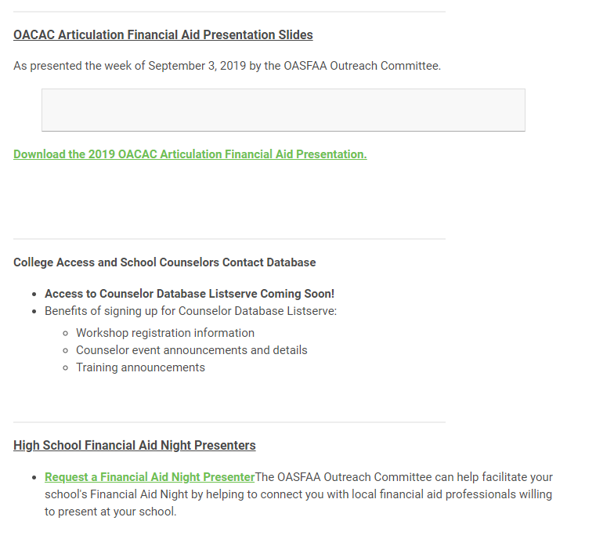

Slide 78
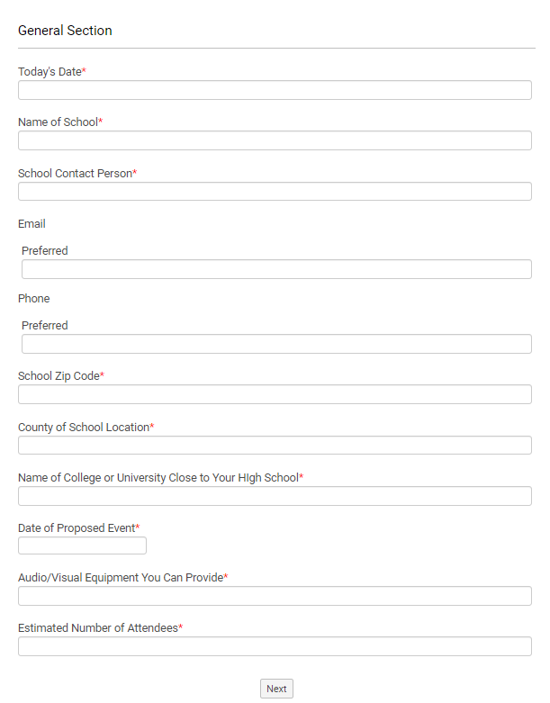
Request a Financial Aid Night Presenter
The OASFAA Outreach Committee can help facilitate your school's Financial Aid Night by helping to connect you with local financial aid professionals willing to present at your school.

Slide 79
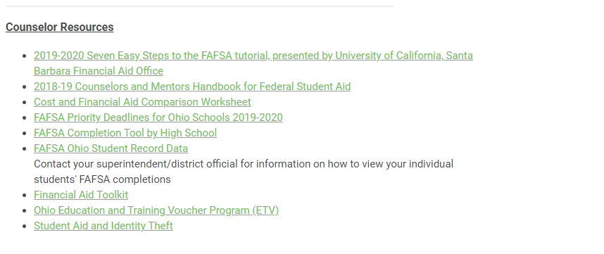

Slide 80
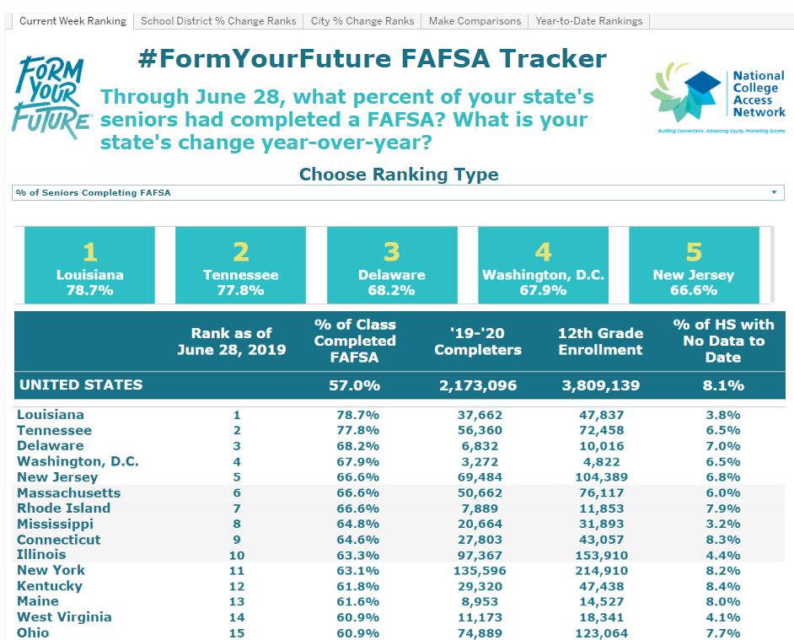
Ohio FAFSA Completions Year over Year
Click here to see the year over year FAFSA completion percentage, courtesy of our friends at NCAN via their Form Your Future web site.

Slide 81
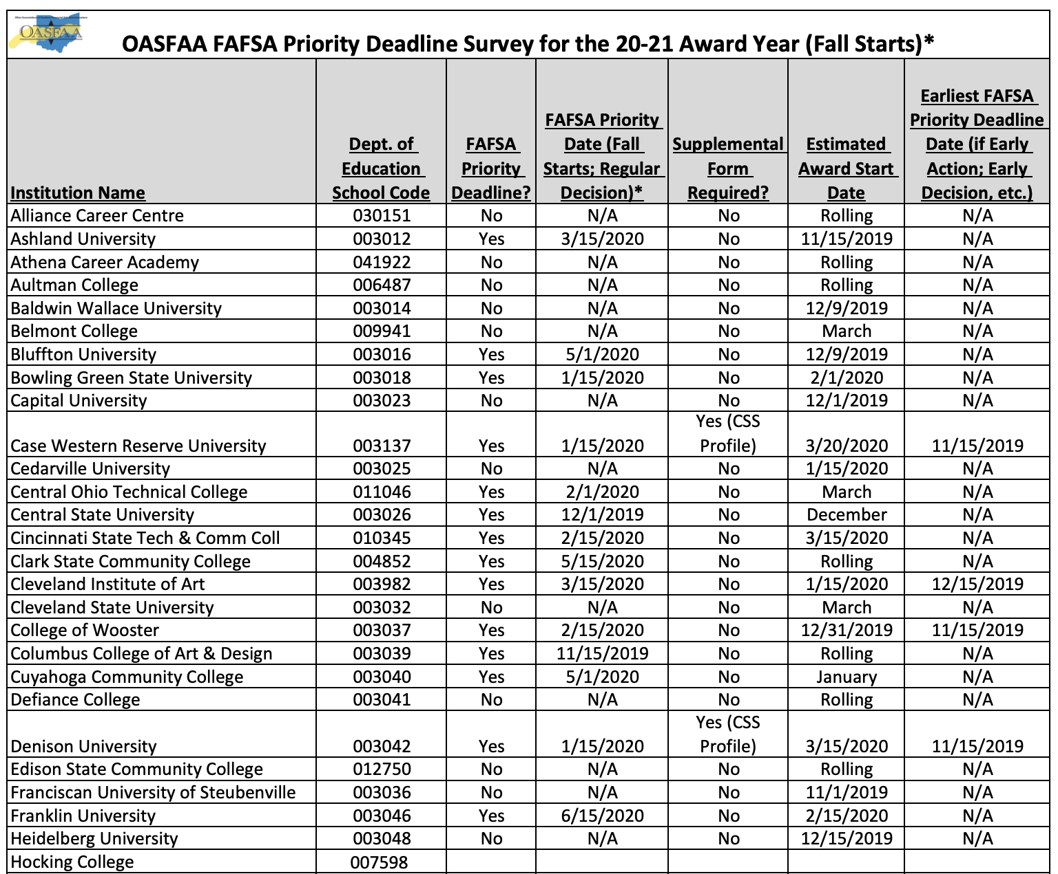
FAFSA Priority Deadlines for Ohio Schools 2020-2021

Slide 82
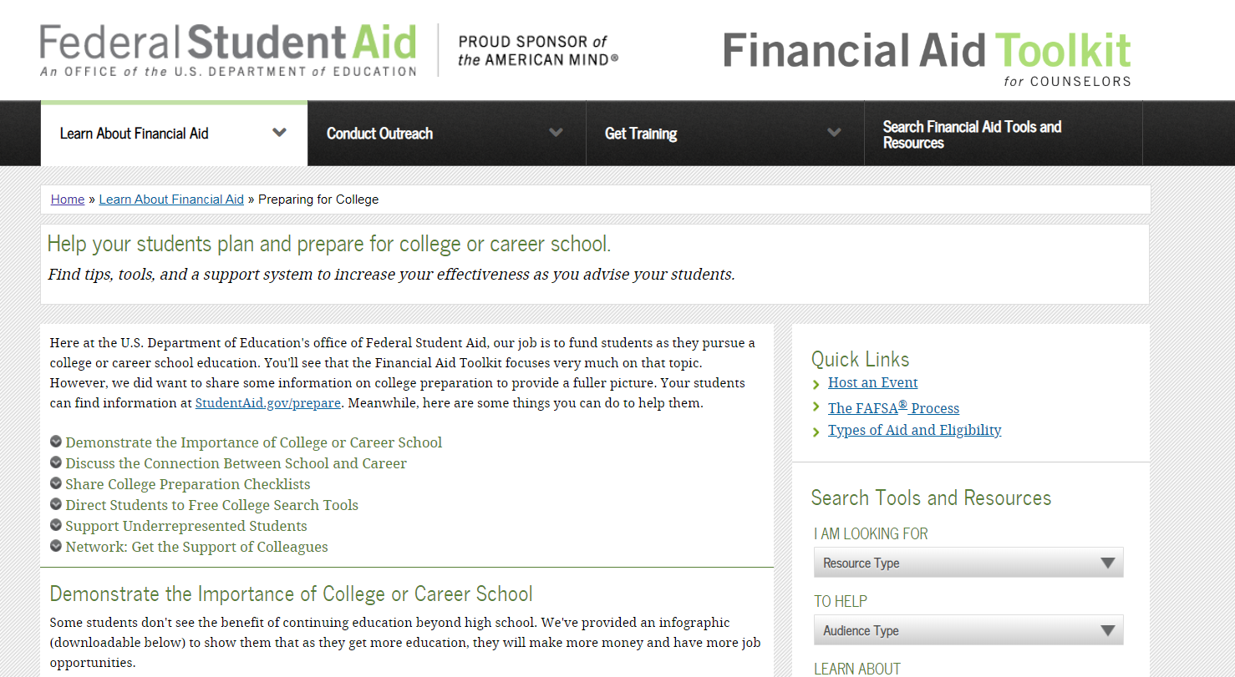
Federal Student Aid Resources are Available
https://financialaidtoolkit.ed.gov/tk/learn/prepare.jsp

Slide 83
QUESTIONS?
Thank you for attending the OASFAA Counselor Workshops.
Please complete the evaluation forms.
***Please see the questions pertaining to the timing of the workshops – October or December***
See you next year!
Notes:
Please stress the importance of completing the evaluation forms…also please highlight that the evaluations contain a question pertaining to the timing of the workshops for 2020: whether the counselors prefer October or December for the workshops (the workshops are being held during both months this year). This question will assist the Outreach Committee next year in planning the workshops if there is a preference for one month over the other.

