Slide 1
Financial Aid 101 2020-2021 For New Counselors
These slides will be posted on www.oasfaa.org (Resources/Counselors)
Presenter: Faith Phillips
Title: Director, Financial Aid
College: Central Ohio Technical College/ Ohio State Newark
Email: Phillips.495@osu.edu
The webinar will begin at 2:00 pm EDT.

Slide 2
About OASFAA & This Presentation
This webinar is sponsored by the Ohio Association of Student Financial Aid Administrators (OASFAA)
OASFAA is a non-profit organization comprised of volunteer financial aid professionals.
OASFAA has provided the information today as a free service to counselors.
You have permission to copy and distribute these materials to your students and families. Charges may not be assessed for the material or for the information presented. Permission must be granted for other use of this information or these materials. Contact the OASFAA Outreach Chairperson(s) listed on the OASFAA website, or e-mail the OASFAA Outreach Committee at outreach@oasfaa.org.

Slide 3
Financial Aid 101 Financial Aid Information for 2020-2021
This presentation draws on information from OASFAA, the National Association of Student Financial Aid Administrators (NASFAA) and Federal Student Aid (FSA).
Today’s webinar in an introduction to financial aid. For a more in-depth presentation and discussion you are encouraged to attend an OASFAA counselor workshop October 7 - 18 or December 2 - 13. These are offered around the state of Ohio at 12 locations.
Registration is now open. Go to: www.oasfaa.org (Resources>Counselors).

Slide 4
What is FAFSA and Financial Aid?
FAFSA = Standard FREE form that collects information about the student and the parent. You do not need to pay to submit the FAFSA.
Financial aid = Funds provided to students and families to help pay for educational expenses.

Slide 5
FAFSA
Information used to calculate the Expected Family Contribution (EFC)
Measure of taxable and untaxable income (2018) and current assets of student and parent
Also based on family size, number in college and other demographic info such as marital status
Colleges use the EFC to award financial aid
EFC stays the same regardless of where the student goes to college
For the 2020-2021 academic year, the FAFSA may be filed beginning
October 1, 2019
Re-apply every year
The earlier you file, the earlier you may receive your aid package and the more aid you may be eligible for
Most colleges set FAFSA filing priority dates
Admissions process vs. Financial Aid process

Slide 6
A Word about DEADLINES
FAFSA Priority Deadlines
How/When to file if dealing with early deadlines:
Follow FAFSA directions per College or University
Use IRS Data Retrieval Tool (IRS DRT)
2018 income tax returns should be complete
Ability to meet early deadlines without estimating data
What are Ohio colleges and universities doing about deadlines?
Note: There may be other deadlines…
https://www.oasfaa.org/assets/FAFSA_PriorityDeadline_OASFAA_20-21%20v.3.pdf
Notes:
FAFSA filing deadlines can be found on the FAFSA Priority Deadline Survey which is posted under Resources section, for counselors.

Slide 7
Principles of Need Analysis
Parents have the primary responsibility in paying for dependent child’s education (to extent they are able)
Students also have a responsibility to contribute to their educational costs
Families should be evaluated in their present financial condition
For the 2020-2021 FAFSA, families will report their 2018 taxable and untaxable income
Recent FAFSA changes (move to prior prior year income) may necessitate more professional judgements by the institutions
A family’s ability to pay for educational costs must be evaluated equitably and consistently
Recognizing that special circumstances can and do affect a family’s ability to pay

Slide 8
What is Expected Family Contribution (EFC)?
Two components
Student contribution
(Income + Assets)
Parent contribution
(Income + Assets)
(for dependent students)
+
Amount family can reasonably be expected to contribute?
Index: “This is the number that is used to determine your eligibility for federal student financial aid.” The formula does not measure willingness to pay
Stays the same regardless of college
Calculated using data from federal application form (FAFSA) and a federal formula

Slide 9
Definition of Need
Cost of Attendance
- Expected Family Contribution (EFC)
= Eligibility (Need-Based Aid)
www.StudentAid.gov/how-calculated

Slide 10
What is Cost of Attendance (COA)?
Estimation of expected costs
Direct Costs
Indirect Costs
Tuition and fees
Transportation
Room and board
Miscellaneous
personal expenses
Books and supplies
Notes:
Direct and Indirect costs combined = COA. Varies widely from College to College.

Slide 11
Multiple Ways to Complete FAFSA
www.FAFSA.gov
Paper
FOTW (Desktop)*
FAFSA
My Student Aid App*
FOTW
(Mobile)*
*IRS DRT Can Be Used
Notes:
www.fafsa.gov

Slide 12
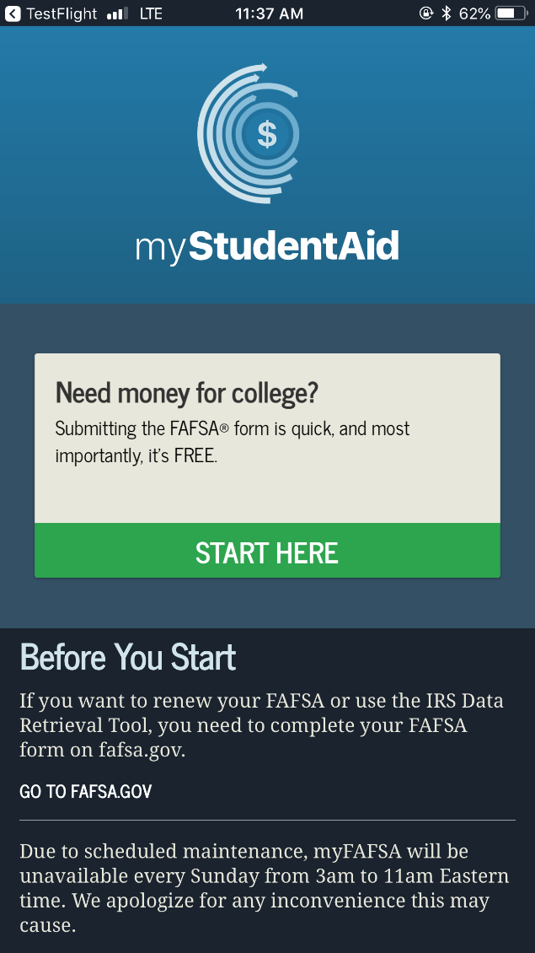
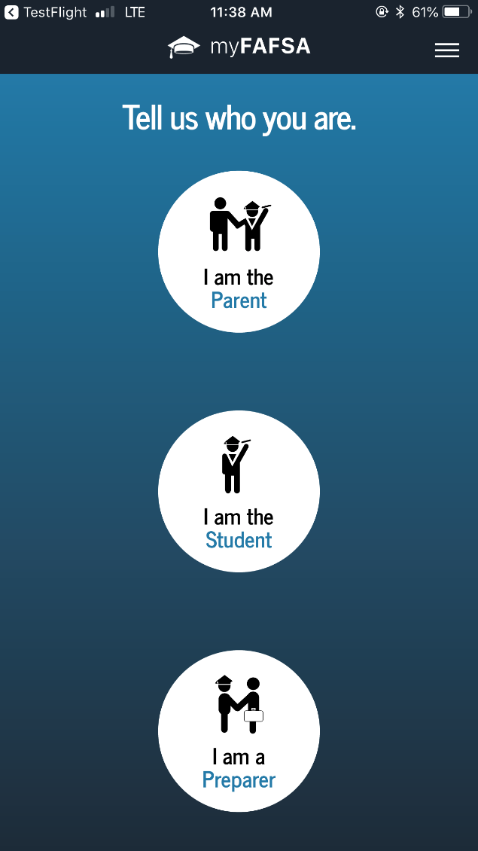
MyStudentAid provides mobile ability to begin, complete, save and submit the FAFSA!

Slide 13
FAFSA ON THE WEB (FOTW)
Built-in edits to prevent costly errors
Skip logic allows student and/or parent to skip unnecessary questions
Option for IRS Data Retrieval Tool
More timely submission
More detailed instructions and “help”
Simplified Process for future years
Notes:
.

Slide 14
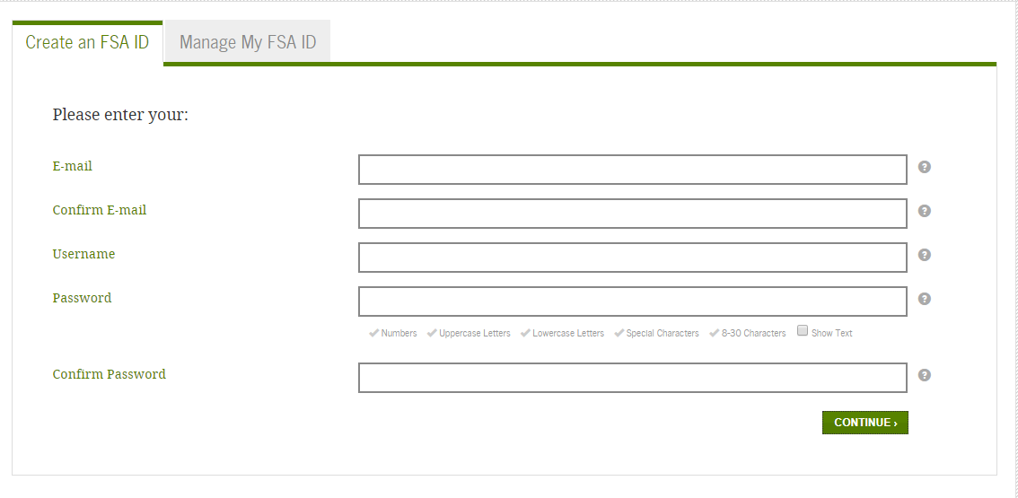
First Step - Request an FSA ID
Process to obtain has 3 main steps
Student and parent will each need individual FSA IDs
Step 1: Enter Log-in Information
Step 2: Enter Personal Information
Step 3: Enter Mailing Address, Email, Phone and language preference, Challenge Questions
Don’t forget to Submit!
https://fsaid.ed.gov

Slide 15
Parents and students Must create their own FSA ID ☺
Parent and student MAY NOT use the same email address
Do not use High School email accounts
Parent only needs one FSA ID for multiple children
Each student must have their own FSA ID and FAFSA
Used for FAFSA completion and allows access to certain U.S. Department of Education websites
Only the owner should create the FSA ID
When possible verity email and mobile phone # using secure code provided
Notes:
Last bullet point - How to determine if FSA ID exists?
Edit my FSA ID – if you are able to log in and see your FSA ID profile, then you have an FSA ID.
Create an FSA ID – will be informed if account already associated w/info. Then proceed w/process to look up password and or username.

Slide 16
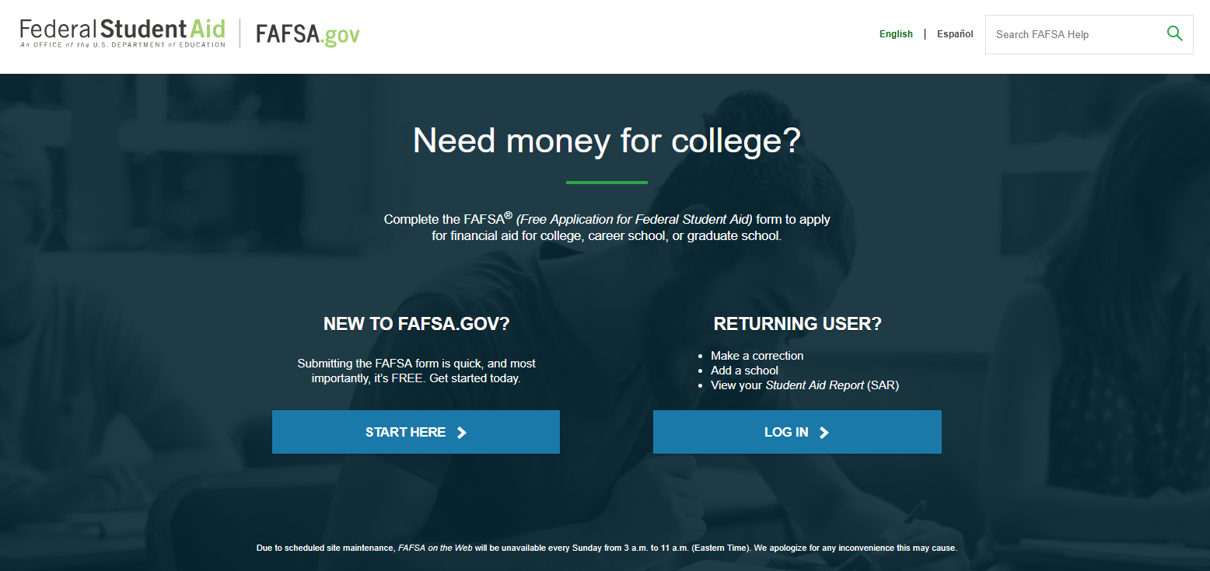
FOTW – Homepage www.fafsa.gov
www.FAFSA.gov

Slide 17
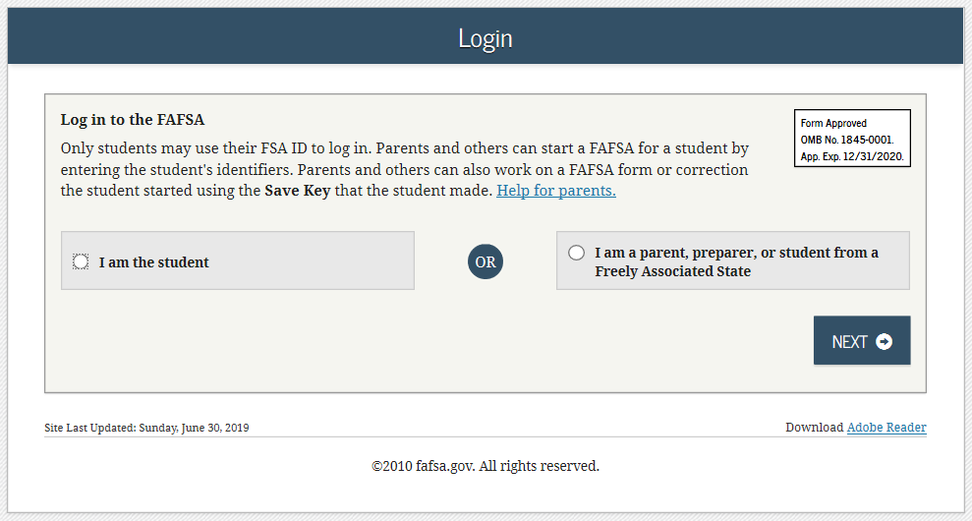
FOTW FAFSA On The Web
FAFSA ON THE WEB (FOTW)
Notes:
Login has changed to make it clearer for parents. The individual selects who they are “student” or “parent”.

Slide 18
Frequent FAFSA Errors
Filing the Wrong FASFA year
Failing to use student’s legal name
Missing financial aid deadlines
Transposing digits or inserting extra digits
Using incorrect Social Security Numbers/Date of Birth
Submitting wrong parent’s financial information/not including step-parent
What untaxed income to report
Incorrectly reporting Household size/number of household members in college
What to include for investment net worth

Slide 19
College and Housing Information
Students can add up to
10 colleges on FAFSA.
For more information and college comparisons, visit the College Navigator website. The following is just some of the information on the website:
College’s website
School type
Tuition and fees
Net price average
Graduation rates
Retention rates
Transfer rates
Notes:
All signature requirements must be met and colleges added before submitting the FAFSA.

Slide 20
Submit the FAFSA

Slide 21
Making FAFSA Corrections
Corrections to FAFSA data may be made on FAFSA on the Web
Add more schools
Correct any mistakes (school may ask you to document)
Do not UPDATE data such as assets/savings
Corrections may be made by submitting documentation to the financial aid office

Slide 22
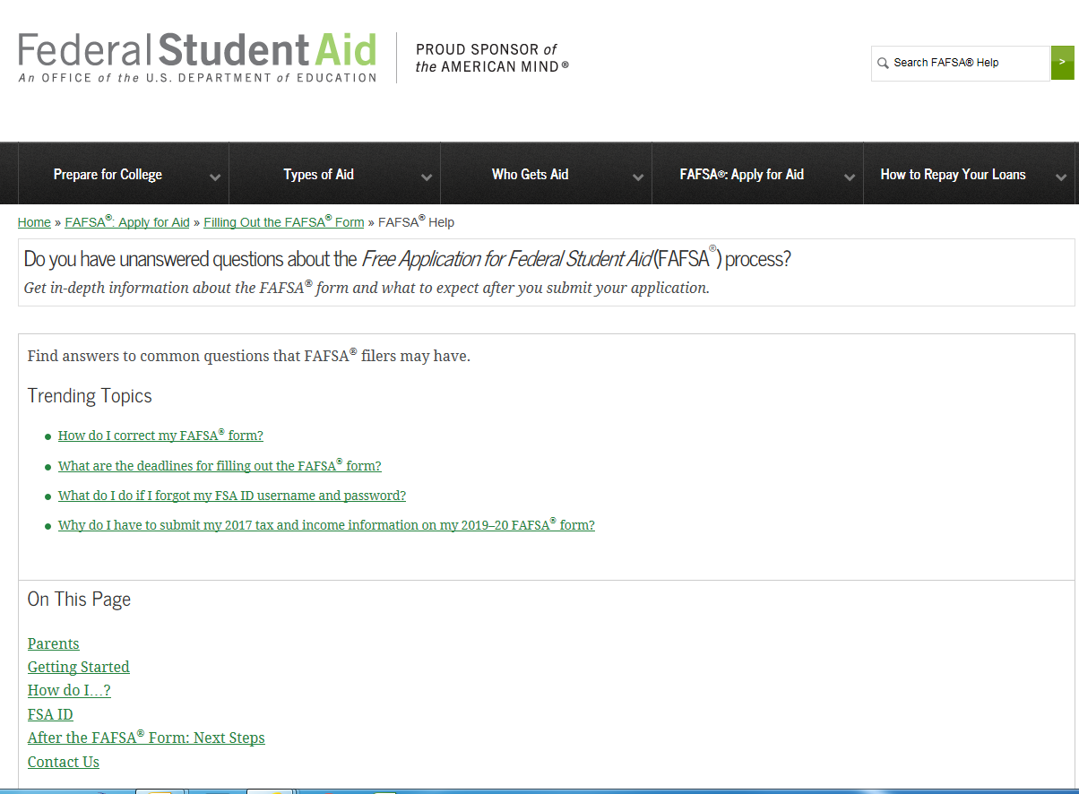
Need Help?
Customer service options include Live Chat Help, a toll-free number, and e-mail.
Completing the FAFSA
Electronically is the best
Option!

Slide 23
Special Circumstances
Secondary school tuition
Unusual uncovered medical/dental expenses
Extraordinary dependent care
Student cannot obtain parental information
Parent or spouse death
Loss of employment
Divorce

Slide 24
If household experiencing significant changes to financial situation
Complete the FAFSA to the extent are able and submit as instructed
Consult with the financial aid office at each college
Parent loss of job/income
Retirement
Separation or divorce
Parent death
Child support ending
One-time income or unusual debt
Medical expenses not covered by insurance
Property loss not covered by insurance

Slide 25
Special Circumstances
Conditions exist that cannot be documented with the FAFSA
Send written explanation and documentation to your college’s financial aid office
College will review and request additional information if necessary
Decisions are final and cannot be appealed to U.S. Department of Education

Slide 26
Verification
Process of documenting information provided on FAFSA
If selected and do not provide documents,
Will not receive federal student aid
Might not receive aid from other nonfederal sources

Slide 27
Verification and the IRS Data Retrieval Tool
IRS DATA RETRIEVAL TOOL
Intended to make FAFSA completion easier
Tax info securely transferred from IRS to FAFSA form
Voluntary participation
Typically reduces number of documents requested for verification process
VERIFICATION
Selected by the Federal Gov’t or college/university
Tax return transcript or Tax Return required if didn’t use IRS DRT
Non-tax filing status documentation required
Aid cannot be disbursed without completion
Required documentation sent to financial aid offices, not Federal Gov’t

Slide 28
Financial Aid Office reviews FAFSA
Determines Financial Aid Award Offer
Usually emailed
Amount of Aid awarded from each program
How and When aid is disbursed
Terms and Conditions of student’s award

Slide 29
Sources of Financial Aid
Federal Government
States
Employers
Private Sources
College and Universities

Slide 30
Types of FINANCIAL Aid
Scholarships
Grants
Loans
Employment
Gift Aid
Self-Help Aid

Slide 31
Categories of Financial Aid
Gift Aid
Grants
Work-study Jobs (Federal)
Self-Help Aid
Some require a FAFSA, some do not/always encourage to file a FAFSA
Loans
Unsubsidized student loans
Private student loans
VA Benefits
Work-study Jobs (Institutional)
Merit Based
Scholarships (performance)

Slide 32
Need Comparison
The Federal Expected Family Contribution (EFC) is the same at each institution.
Net Price Calculator – Great tool for students

Slide 33
Scholarship Searches & SCAMS
Scholarship Scams (free vs. paying a fee)
Buyer beware ☹
Project Scholarship Scam
www.ftc.gov/scholarshipscams
Pursue local scholarships!
Civic Organizations, Churches, Employers, Financial Institutions, etc.
Check with Colleges and Universities
Scholarship Search Engines
Recommended by the US Dept. of ED
https://www.careeronestop.org/toolkit/training/find-scholarships.aspx
Notes:
College & Universities bullet point
as they may also be aware of external scholarships (as well as institutional scholarships)

Slide 34
Ohio Aid Programs 2020-2021
Ohio College Opportunity Grant (OCOG)
Ohio War Orphans Scholarship
Ohio Army National Guard Scholarship
Safety Officers College Memorial Fund
Nurse Education Assistance Loan Program (NEALP)
Choose Ohio First Scholarship

Slide 35
Ohio College Opportunity Grant (OCOG)
OHIO Department of Higher Ed (ODHE) Eligibility criteria
FAFSA filed by indicated deadline
Ohio resident
Attend eligible OH or Pennsylvania institution
Public and Private Colleges participate
EFC ≤ 2190
Maximum household income of $96,000
Can receive for maximum of 10 semesters or 15 quarters of enrollment
Notes:
FAFSA deadline for OCOG is October 1 of each year.
Assists/awarded to 10s of 1000s of students annually.

Slide 36
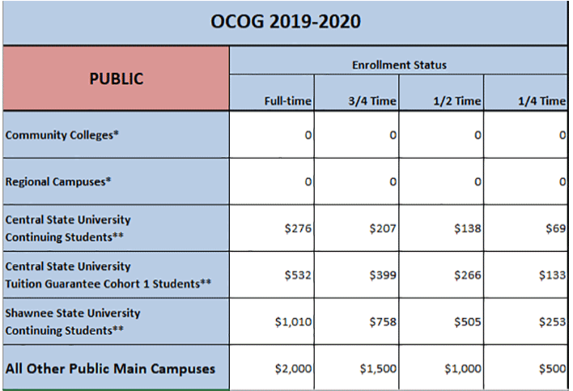
Ohio College Opportunity Grant (OCOG), 2019-2020
Students attending community colleges and regional campuses are eligible to receive OCOG if they are eligible for ETV, as foster youth students.
From https://www.ohiohighered.org/ocog
Notes:
Mention that ETV is the Ohio Education and Voucher Training Program.
Eligible foster youth at community colleges may qualify for OCOG using main campus maximum award amounts.
*The fixed Pell/EFC combo of $6,195 continues to exceed the average tuition and general charges at community colleges and therefore no OCOG awards will be available to students attending these institutions. However, if a student in this sector attends an eligible institution year-round, a main campus term award may be distributed once Pell grants have been exhausted.
*The average tuition and general charges at university regional campuses slightly exceeds the fixed Pell/EFC combo of $6,195. Therefore, a modified maximum OCOG award amount will be available to students attending these institutions. However, if a student in this sector attends an eligible institution year-round, a main campus term award may be distributed once Pell grants have been exhausted.

Slide 37
Federal Work-Study
Undergraduate or graduate students are eligible
Employment can be on or off campus
FWS wages excluded from EFC calculation!!!
Eligible employers
School
Federal, state, or local public agency
Private non-profit organization in academically relevant jobs
For-profit organization in academically relevant jobs
Community service activities
FAFSA Priority Deadline for campus based programs
Ohio minimum wage in 2019: $8.55 per hour
Notes:
2019 Ohio minimum wage updated to $8.55 from 2018 $8.30

Slide 38
Federal Pell/SEOG Grants
Pell Grant (2019-2020) EFC of 0000 = $6,195 maximum Pell EFC of 5576 = $657 minimum Pell *Need Based
Federal SEOG Grant: (Campus Based) *Exceptional financial need *Lowest EFC’s (Pell Eligible students are priority) *Award ranges from $100 to $4,000
FAFSA Priority Deadline for campus based programs
Notes:
Pell #s updated
FSEOG stayed the same

Slide 39
Student Loans
Key Points:
Students can borrow direct loans without any credit check or income
Parents can borrow direct PLUS loans on behalf of their dependent student.
Their credit record will be checked.
Only borrow what is really needed
Look at loans as an investment in the future

Slide 40
Student Loans PROCESS
File the FAFSA
Review financial aid award letters from schools to learn about eligibility
Go to www.studentloans.gov
Sign in using your Federal Student Aid ID (FSA ID)
Student:
Complete Entrance Counseling AND MPN (Master Promissory Note)
Parent (for Parent PLUS loan only):
Complete PLUS application AND MPN

Slide 41
Need More Help?
Federal Student Aid Information Center:
1-800-433-3243 (1-800-4fedaid)
Phone system available 24/7
Agents available 8 a.m. – 10pm EST (M-F)
FSA ID Help:
FSA ID FAQs - https://fsaid.ed.gov/npas/pub/faq.htm
1-800-433-3243 (1-800-4fedaid)

Slide 42
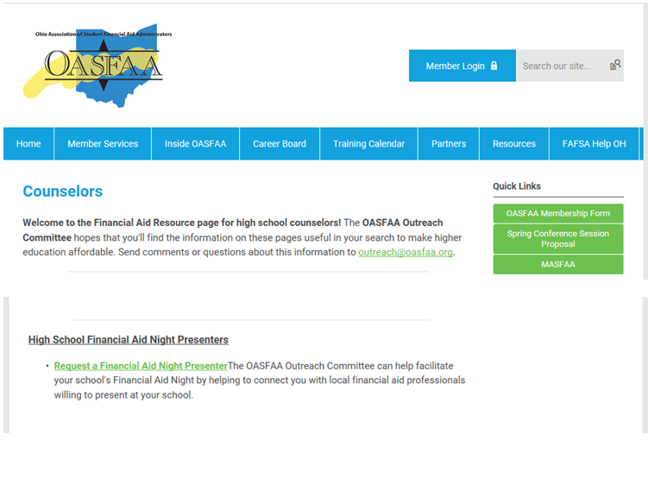
The OASFAA Outreach Committee can help facilitate your school's Financial Aid Night by helping to connect you with local financial aid professionals willing to present at your school.
Notes:
Visit the OASFAA website go to Resources, counselors, High School Financial Aid Night Presenters, Request a Financial Aid Night Presenter.

Slide 43
Questions?
outreach@oasfaa.org
Make sure you put your name and email address into our College Access and School Counselors Contact Database
Web: http://www.oasfaa.org/ (page for counselors)
Request an OASFAA volunteer High School Financial Aid Night presenter.
Register for October/December Counselor Workshops (Registration is live).
Sign up for our email database to be sure you are notified for all events.
Notes:
Please quickly review this slide and leave it up during remaining Q&A.

